Slide 1

Measure
What
Matters
December 12, 2018
Education 20/20 Series - Ian Rowe

Slide 2
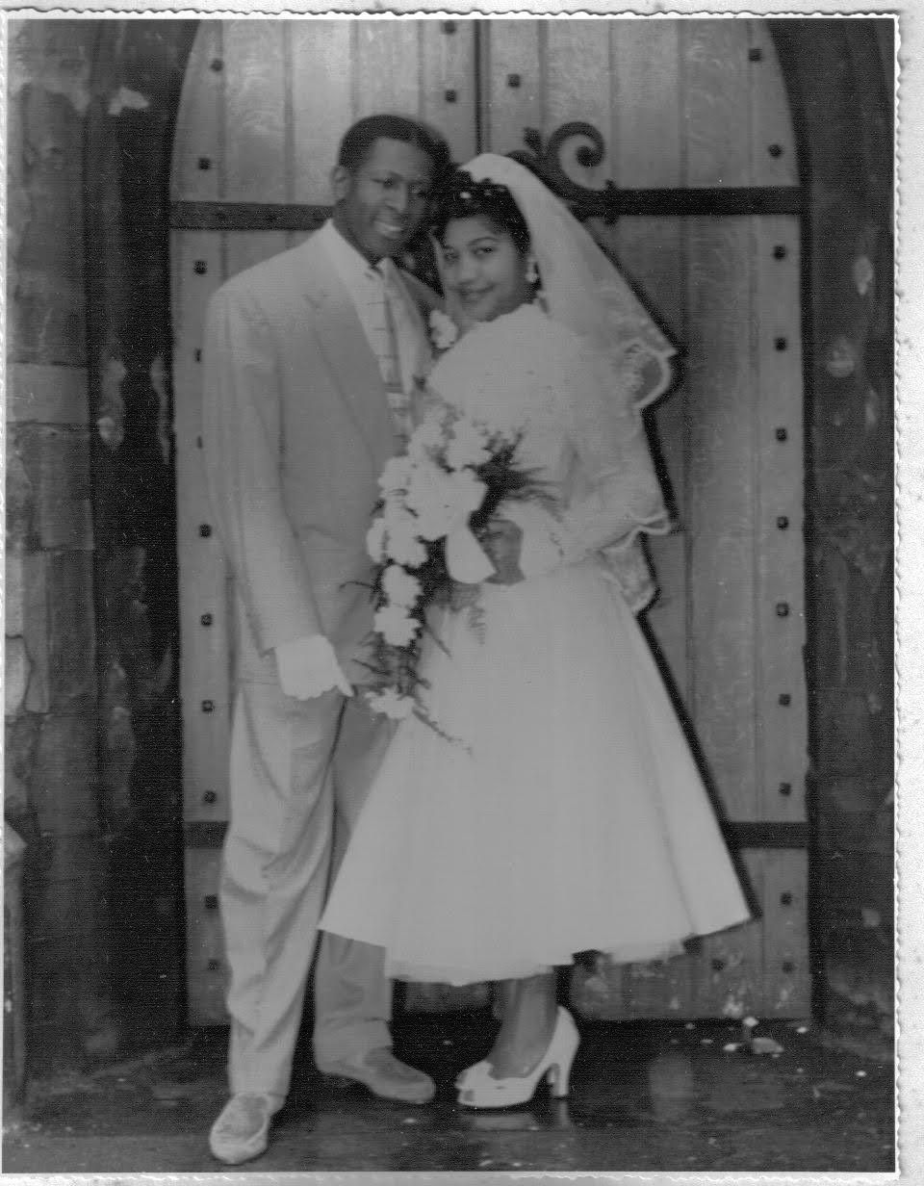

My Story

Slide 3

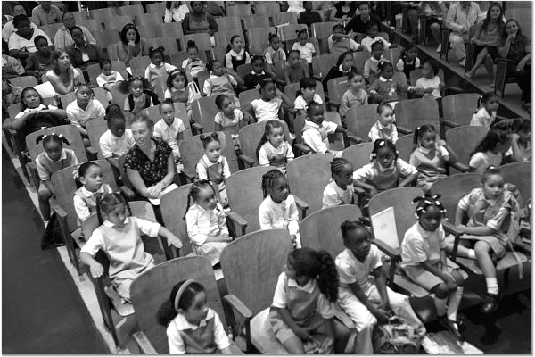
Girls Prep Then (2005) & Now

Slide 4



Slide 5
NYC District Ranking by Child Wellbeing
2015 HIGHEST RISK COMMUNITY DISTRICT Hunts Point (Bronx 02)
Early Education Enrollment | ELA State Test Pass Rate | Math State Test Pass Rate | High School Graduation Rate
53% | 10.5% | 12.1% | 37.2%
2015 LOWEST RISK COMMUNITY DISTRICT Upper East Side (Manhattan 08)
Early Education Enrollment | ELA State Test Pass Rate | Math State Test Pass Rate | High School Graduation Rate
81.9% | 64.5% | 71.1% | 81.1%

Slide 6


Who’s Your Daddy?
Mobile DNA Testing Center
Swab Stories
VH1

Slide 7
NYC Child Well Being District Ranking
2015 HIGHEST RISK COMMUNITY DISTRICT Hunts Point (Bronx 02)
Children in Single-Parent Families | Teen Birth Rate | Teen Idleness (16 to 19 years) | Adults Without a High School Degree
60.0% | 28.0% | 19.0% | 42.5%
2015 LOWEST RISK COMMUNITY DISTRICT Upper East Side (Manhattan 08)
Children in Single-Parent Families | Teen Birth Rate | Teen Idleness (16 to 19 years) | Adults Without a High School Degree
13.9% | 3.8% | 1.5% | 1.9%

Slide 8
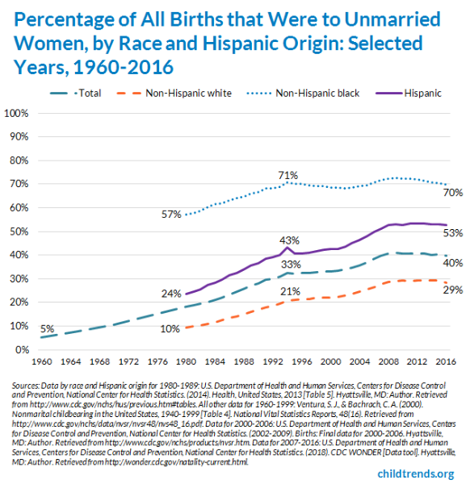
Changing Family Structure

Slide 9
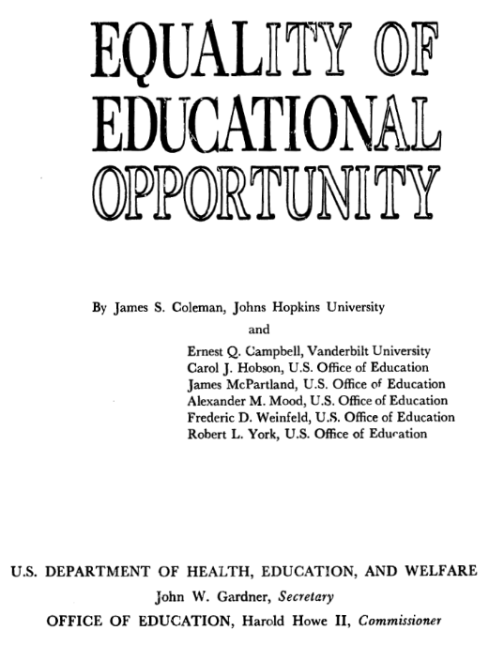
The Coleman Report - 1966
The Civil Rights Act of 1964 required a survey "concerning the lack of availability of equal educational opportunities for individuals by reason of race, color, religion, or national origin in public educational institutions."
Surveyed 4,000 schools; 645,000+ American school children
“Taking all these results together, one implication stands out above all: That schools bring little influence to bear on a child’s achievement that is independent of his background and general social context; and that this very lack of an independent effect means that the inequalities imposed on children by their home, neighborhood, and peer environment are carried along to become the inequalities with which they confront adult life at the end of school.”

Slide 10

The Moynihan Report - 1965
“Three centuries of injustice have brought about deep-seated structural distortions in the life of the Negro American. At this point, the present tangle of pathology is capable of perpetuating itself without assistance from the white world,”
“...at the center of the tangle of pathology is the weakness of the family structure. Once or twice removed, it will be found to be the principal source of most of the aberrant, inadequate, or antisocial behavior that did not establish, but now serves to perpetuate the cycle of poverty and deprivation.”

Slide 11
Equal Opportunity Tsunami
2015 US Births to Women Aged 10 to 24 (Total and Unmarried)
 | White | Black | Hispanic | Total
Births to All Women (Age 10–24 | 490,788 | 226,481 | 317,614 | 1,034,883
Births to Unmarried Women Aged 10–24 | 301,894 | 204,631 | 231,950 | 738,475
Percent to Unmarried Women (Aged 10–24) | 61.51% | 90.35% | 73.03% | 71.36%

Slide 12
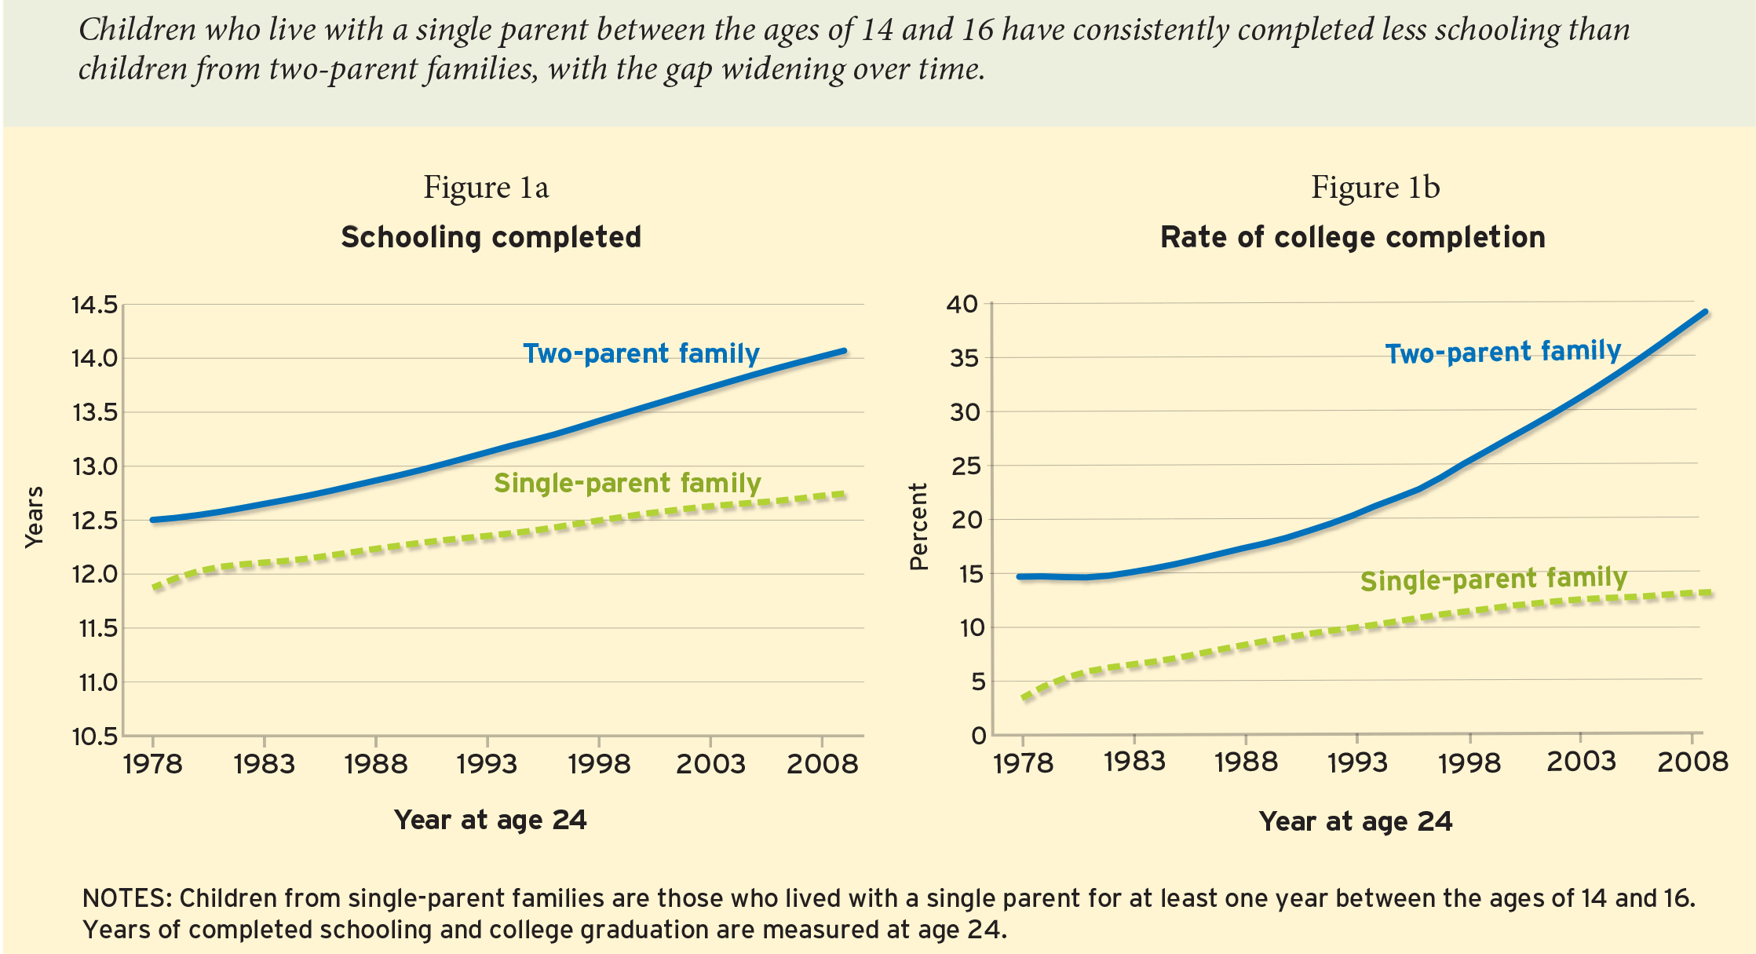
Education Outcomes by Family Type

Slide 13
National Center for Health Statistics
Family Structure & Children’s Health in the US (2010)
“In view of the changing family structure distribution, new categories of families such as unmarried families or unmarried stepfamilies need to be studied so that the health characteristics of children in non-traditional families can be identified.”

Slide 14
National Center for Health Statistics
Seven distinct, mutually exclusive family structures:
Nuclear (Married, two-parent, biological or adoptive)
Single-parent
Blended
Unmarried biological or adoptive families
Co-habiting
Extended
Other (related or unrelated adults who are not biological or adoptive parents (e.g. grandparents).

Slide 15
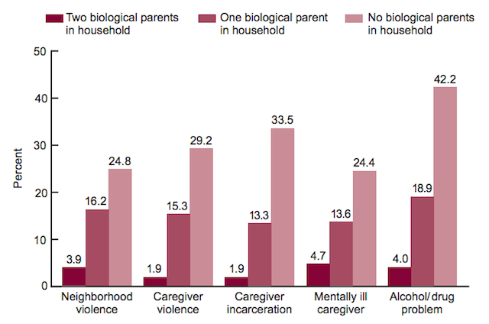
National Center for Health Statistics

Slide 16
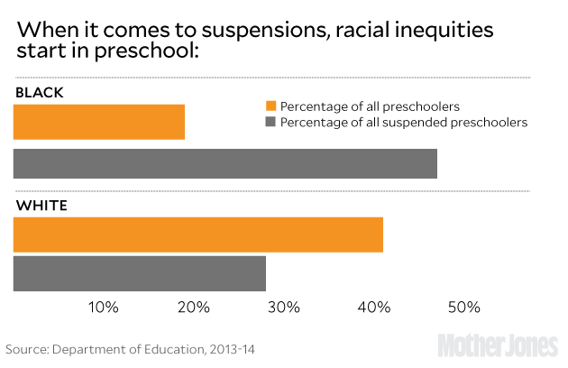
Racial Disparities in PreK Suspensions

Slide 17
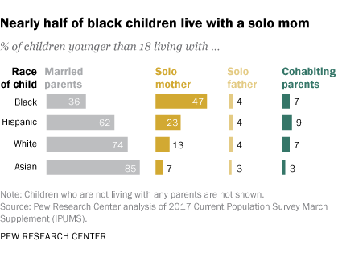
Could Family Structure be a Factor?

Slide 18
Family Structure Matters
We must remove taboo to discuss family structure. Have COURAGE!
What should we do early for children being raised in fragile families?
What to teach the next generation re choices most linked to life success?
Measure academic outcomes by family structure (+race, gender, class)

Slide 19
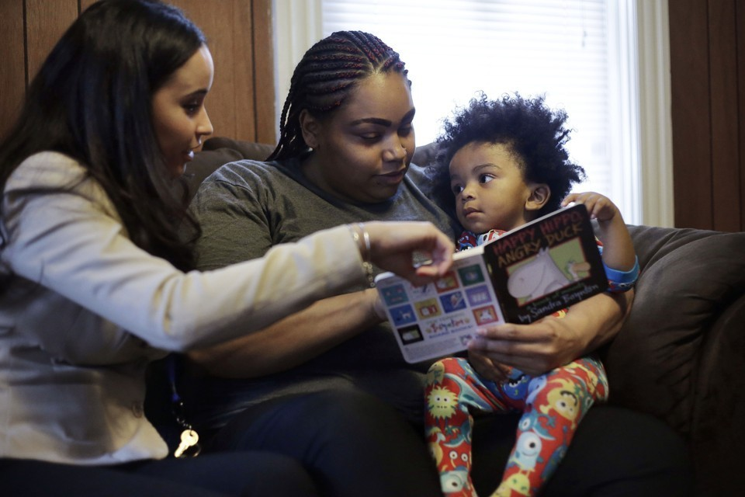
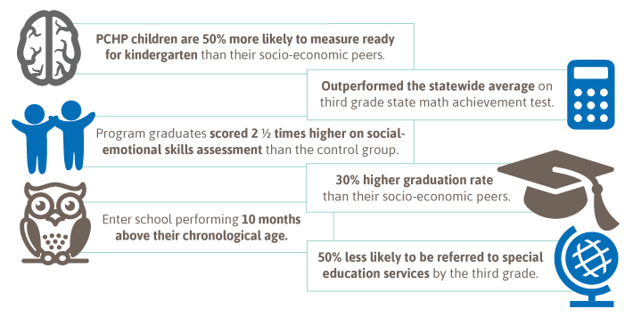
Parent Child Home Program
Through Public Prep’s partnership, younger siblings of current Boys Prep and Girls Prep students who are toddlers as young as eighteen months old will receive nearly one hundred home visits and a two-year literacy head start before they receive automatic lottery preference into PrePrep.
For two years — two times each week — a trained, community-based early learning specialist will bring a new high-quality book or educational toy that is a gift to the family.

Slide 20

Pathways to Power/Personal Agency
June 2017 - Girls Prep at AEI - “Success Sequence” research by Ron Haskins and Isabelle Sawhill, senior fellows at the Brookings Institution. Among U.S. adults who graduated from high school, got a full-time job (or belonged to a family where someone did), and then delayed having babies until after they were 21 years old and married, only about 2% lived below the poverty line.
Meanwhile, 71% ended up in the middle class or above.

Slide 21
Public Prep Core Values
Brotherhood/Sisterhood
Merit
Merit
Responsibility
Responsibility
Scholarship
Scholarship

