Slide 1
The Evolution of Returns to
Cognitive Skills across Countries:
Evidence on Factor Price Equalization
Eric A. Hanushek (Stanford), Guido Schwerdt (Konstanz),
Simon Wiederhold (Halle), and Ludger Woessmann (Munich)

Slide 2
Motivation
Varied discussion of impact of globalization and technology
Different focuses:
  Labor market dynamics
  International trade theory
Prior analysis suffers from both measurement and sampling issues
  Difficulty of assessing comparably skilled workers
  Limited longitudinal data
  Restricted international analysis
What we do
  Estimate returns to skills across countries
  Consider dynamics of returns to skills
  Describe factors behind cross-country differences

Slide 3
Main Results
    Directly address prior measurement and sampling issues
      Exploit consistent international skill measurement over time
      Prior international comparisons all cross-sectional
        Precludes analysis of dynamics
      Prior dynamic comparisons all single-country
        Misses heterogeneity and general equilibrium effects

Slide 4
Main Results
    Directly address prior measurement and sampling issues
      Exploit consistent international skill measurement over time
      Prior international comparisons all cross-sectional
        Precludes analysis of dynamics
      Prior dynamic comparisons all single-country
        Misses heterogeneity and general equilibrium effects
    Key findings
    Considerable variation in returns to skills across countries
    Substantial convergence over time
      Consistent with factor price equalization
    Speed of convergence related to:
      Trade openness, particularly in intangibles
      Labor-market flexibility

Slide 5
Broad and Dense Literature
Estimation of returns to skills following standard models of human capital
  School attainment: Becker (1964), Mincer (1970), Card (2001)
  Cognitive skills: Hanushek/Woessmann (2008, 2011, 2015)
Cross-sectional analyses of differences in returns to skills
  Early U.S. studies: Bishop (1989), Murnane/Willett/Levy (1995), Neal/Johnson (1996), Mulligan (1999), Murnane et al. (2000), Chetty et al. (2011)
  Reviews: Bowles/Gintis/Osborne (2001), Woessmann (2025), Deming/Silliman (2025)
  International: Leuven/Oosterbeek/Ophem (2004), Blau/Kahn (2005), Hanushek/Zhang (2009); PIAAC (2012): Hanushek et al. (2015, 2017)
Changes in returns to skills over time within countries
  U.S.: Murnane/Willett/Levy (1995), Weinberger (2014), Castex/Dechter (2014), Deming (2017); Sweden: Edin et al. (2022), Hermo et al. (2022); Finland: Izadi/Tuhkuri (2024); Germany: Navarini (2023)
International trade and factor price equalization
  Samuelson (1948), McKenzie (1953), Leamer (1984), Davis/Weinstein (2001), Schott (2004), Trefler (1995), Debaere (2003), Mundell (1957), Dixit/Norman (1980), Feldstein/Horioka (1980), Helpman/Itskhoki/Redding (2010)

Slide 6
Two Cycles of PIAAC Data

Slide 7
Two Cycles of PIAAC Data
Programme for the International Assessment of Adult Competencies (PIAAC)
  Cycle 1: 2011/12
  Cycle 2: 2022/23
  Representative samples age 16-65 (~5,000 adults per country)
  Psychometrically linked math and literacy tests
  Noncognitive measures
  Labor market outcomes
  Each survey takes average of ~1.5 hours to complete

Slide 8
Analytical Sample
  Demographics: full-time prime-age (35-54) workers
  Earnings measure: gross hourly earnings
  Skill measure: normalized to international mean 0 and SD 1 in Cycle 1
  Countries: 23 developed countries (matched C1 and C2)
    4 in C2 not matched in C1
    Exclusions: Poland (“unusual response patterns”); Israel, Korea (flawed collection of earnings data); Chile (focus on developed countries)
    NOTE: public use samples here

Slide 9
Empirical Model of Wage Dynamics

Slide 10
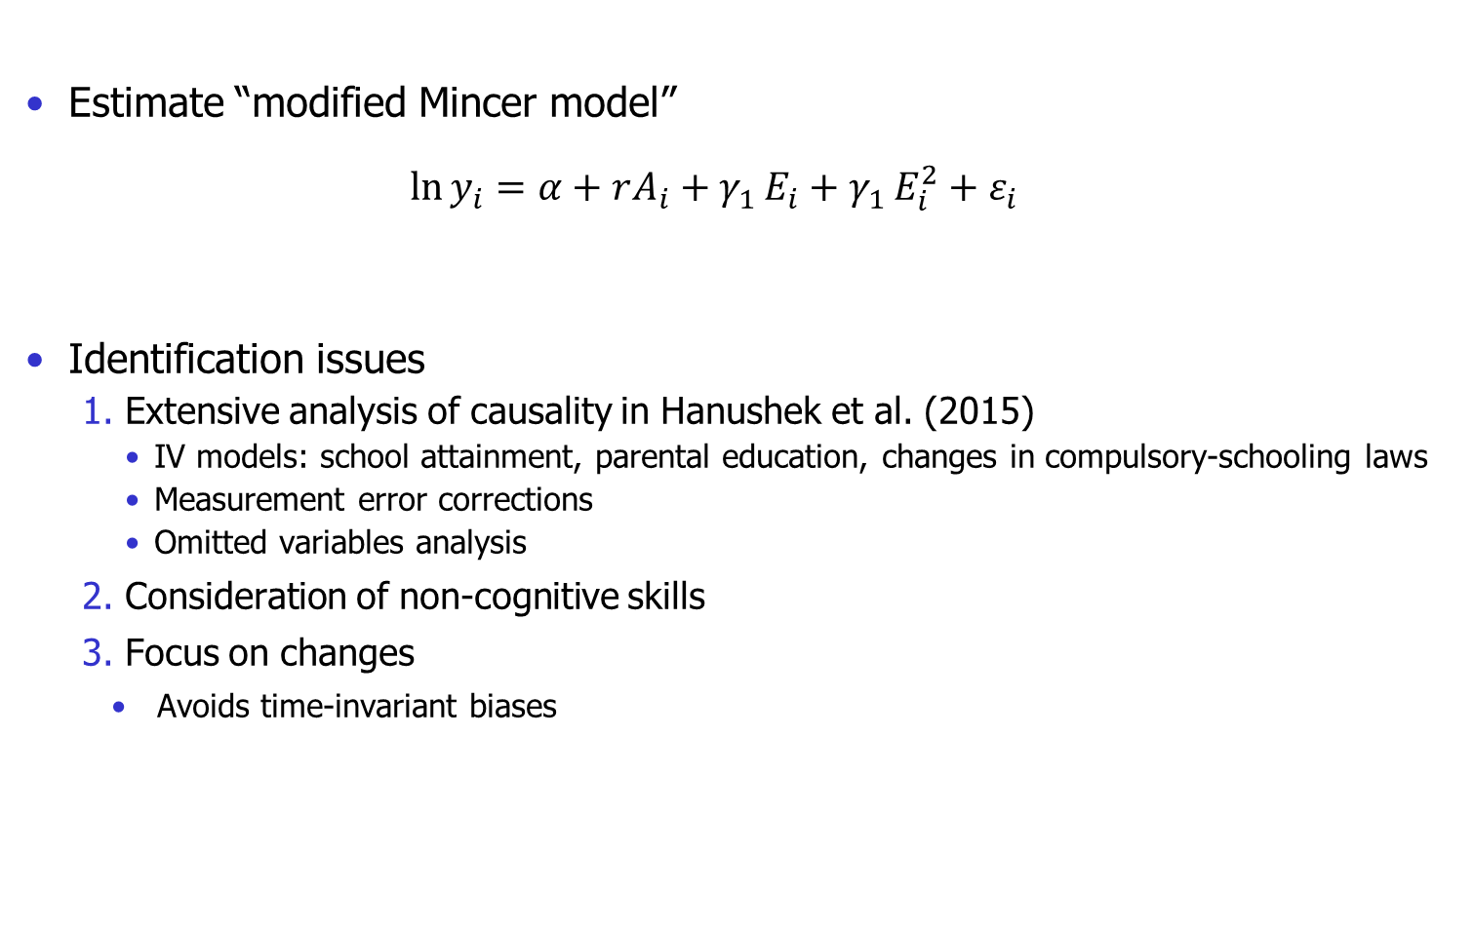
Empirical Model of Wage Dynamics
Estimate “modified Mincer model”
  $$\ln{y_{i}}=α+rA_{i}+γ_{1 }E_{i}+γ_{1 }E_{i}^{2}+ε_{i}$$
Identification issues
  Extensive analysis of causality in Hanushek et al. (2015)
    IV models: school attainment, parental education, changes in compulsory-schooling laws
    Measurement error corrections
    Omitted variables analysis
  Consideration of non-cognitive skills
  Focus on changes
    Avoids time-invariant biases

Slide 11
I. Current Country Variations in Returns to Skills

Slide 12
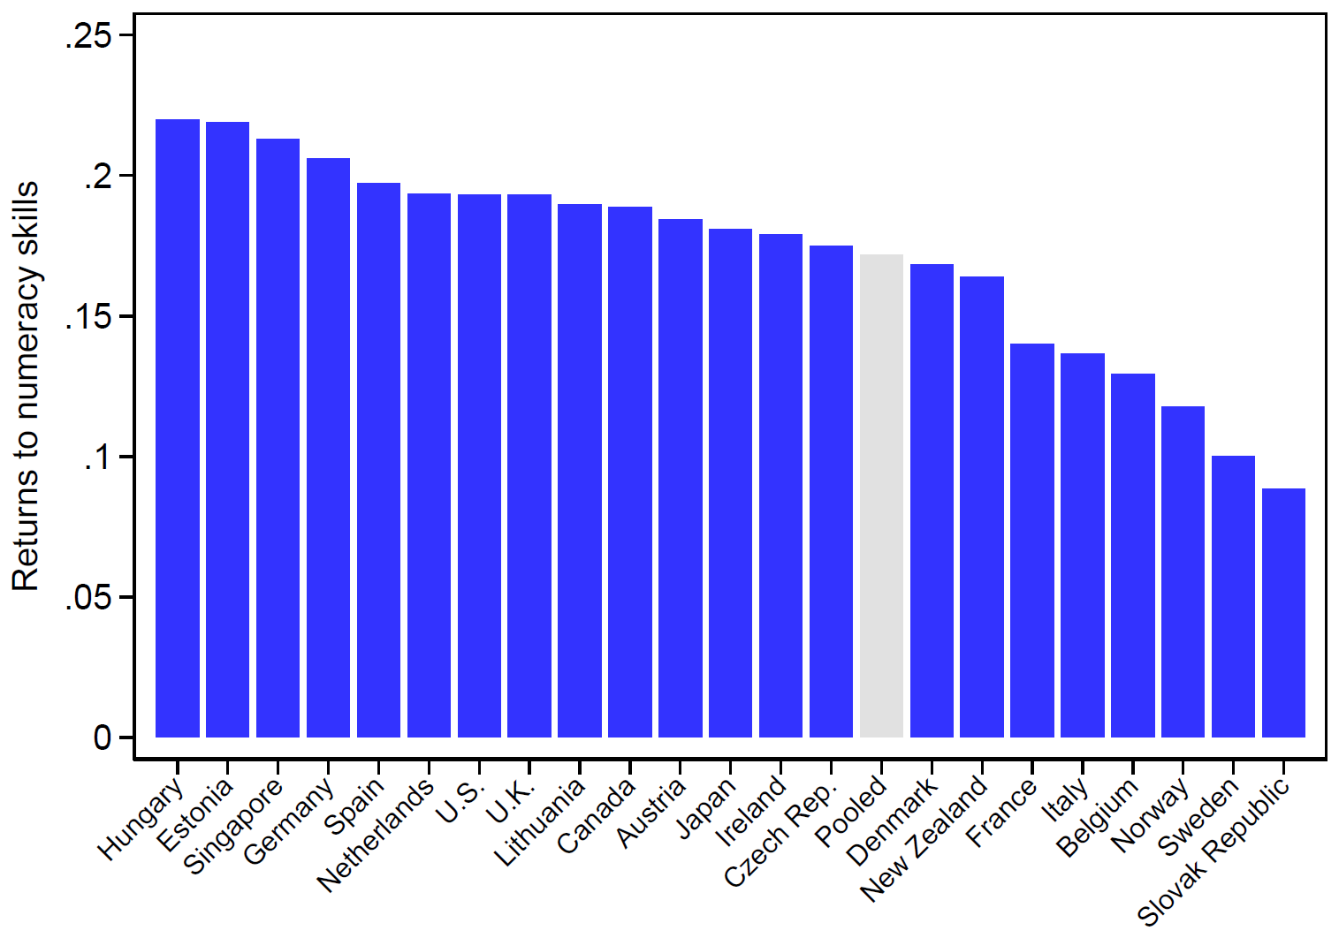
Returns to Cognitive Skills around the World, 2023
17.2%
16.7%

Slide 13
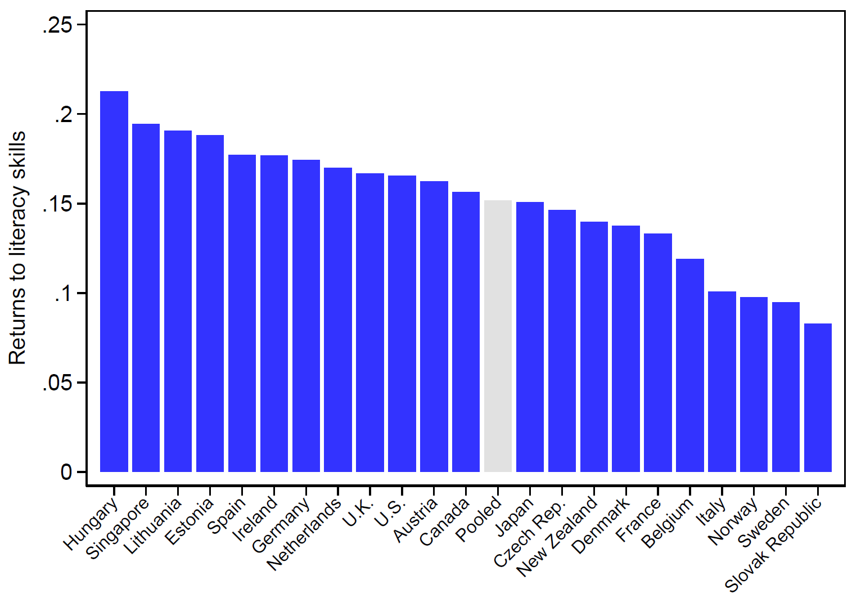
Returns to Literacy Skills around the World, 2023
15.2%

Slide 14
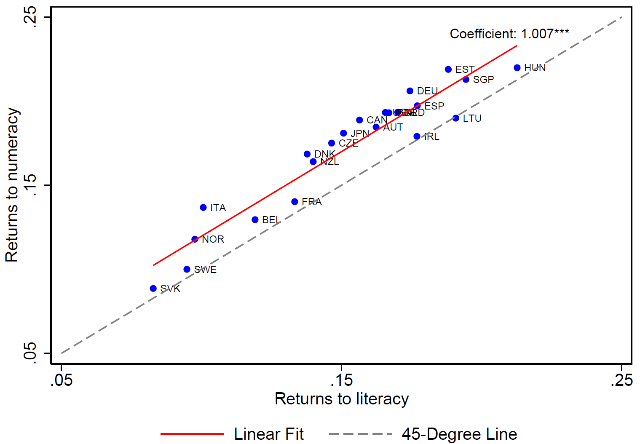
Returns to Numeracy and
Literacy Skills across Countries

Slide 15
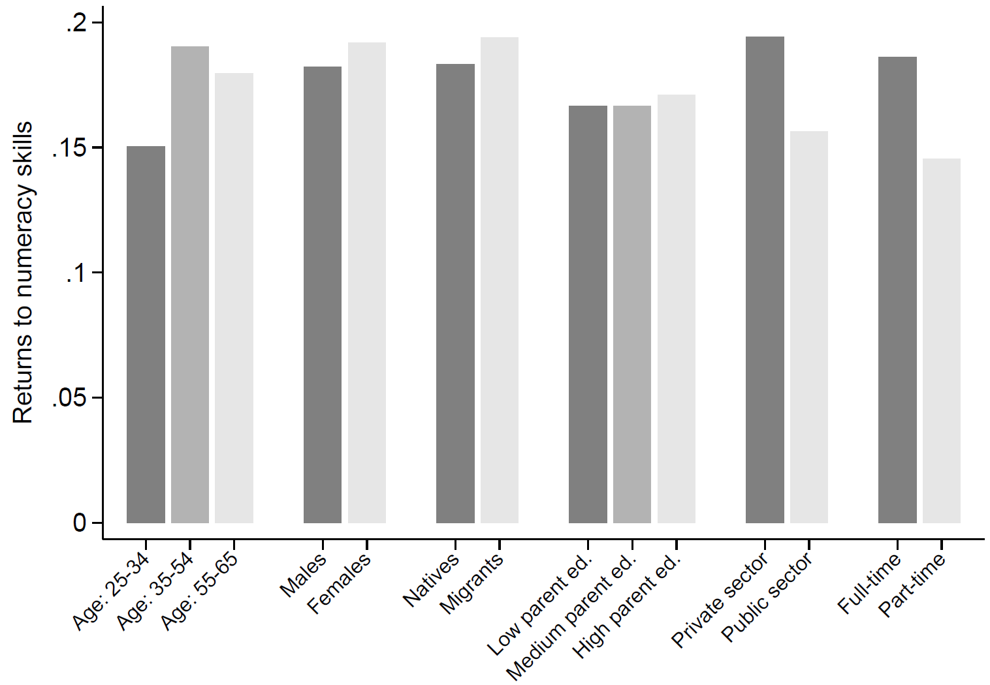
Returns to Cognitive Skills by Sociodemographic Subgroups

Slide 16
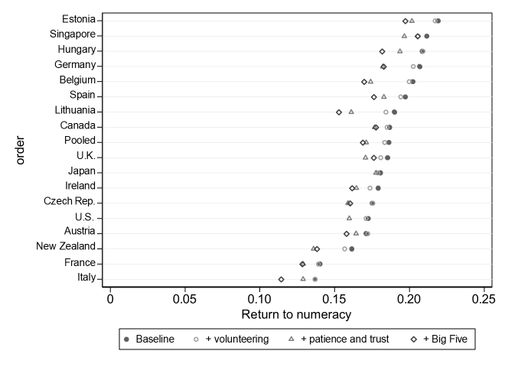
Returns to Cognitive Skills:
Accounting for Non-cognitive Skills

Slide 17
II. The Dynamics of Returns to Skills

Slide 18
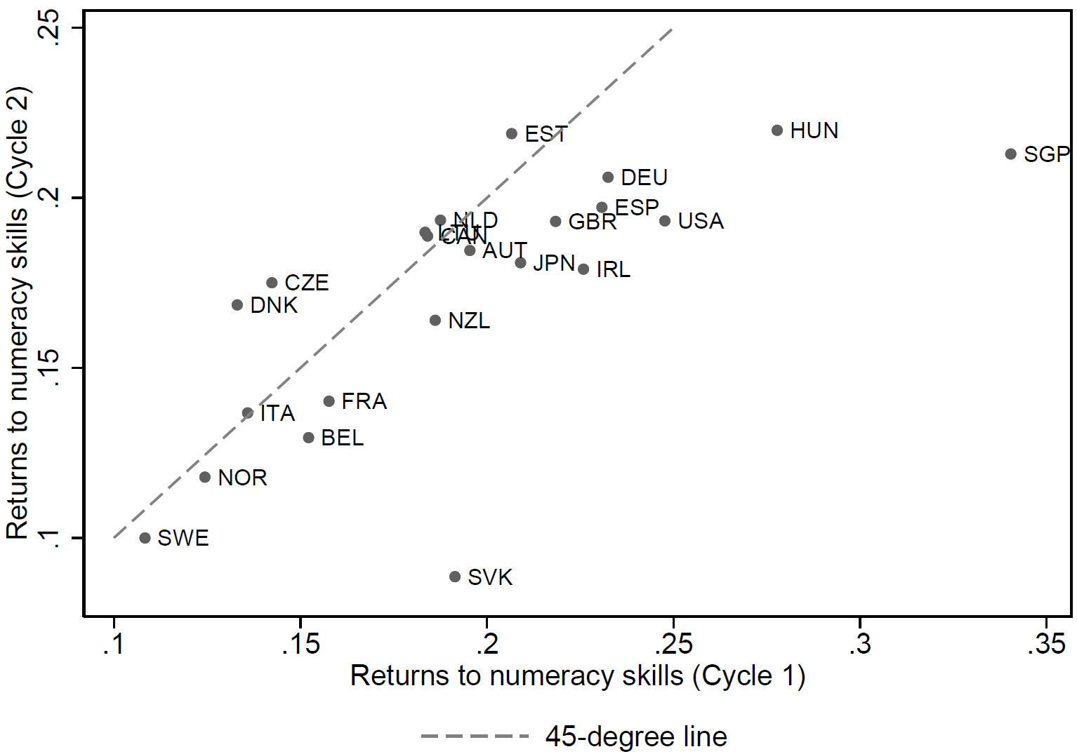
Returns to Cognitive Skills:
2012 vs. 2023

Slide 19
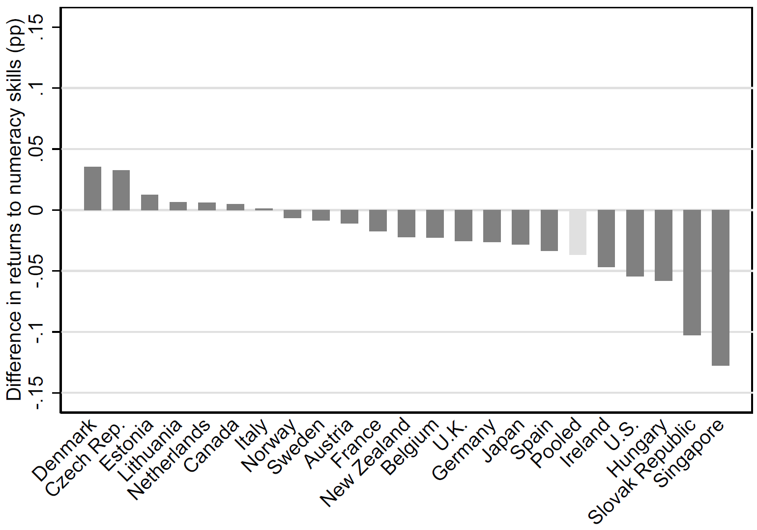
Changes in Returns to Cognitive Skills, 2012-2023
-3.6
-5.3

Slide 20
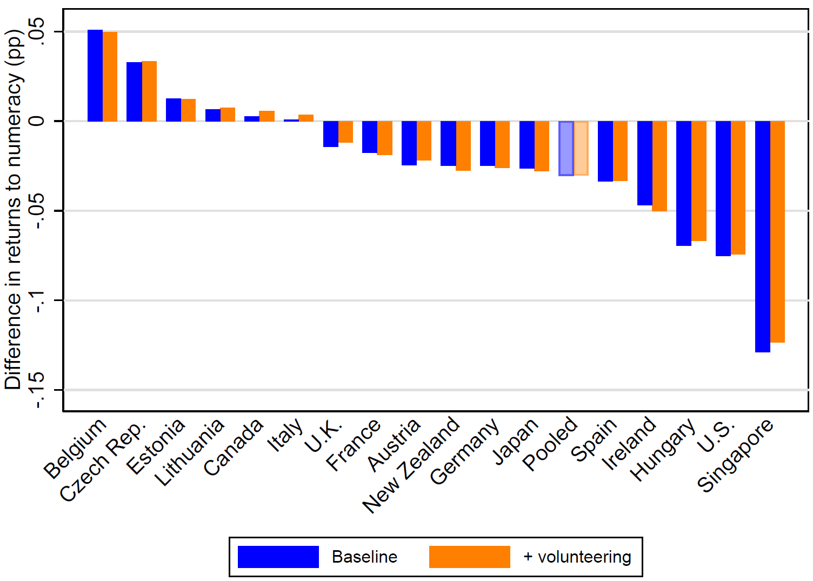
Changes in Returns to Cognitive Skills: Controlling for Volunteering

Slide 21
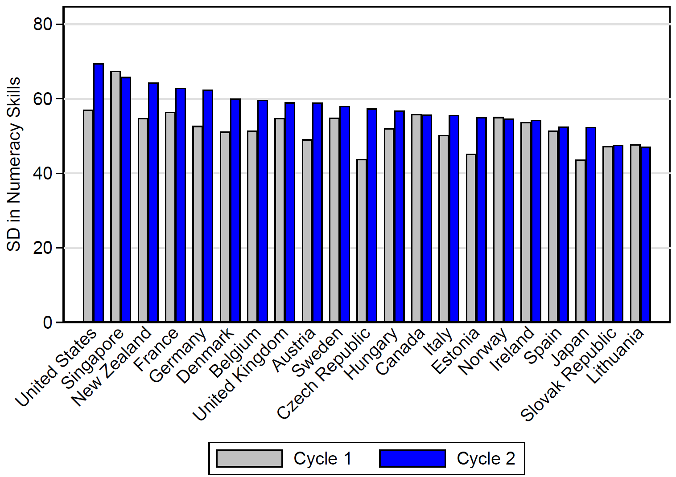
Standard Deviation in Cognitive Skills, 2012 and 2023

Slide 22
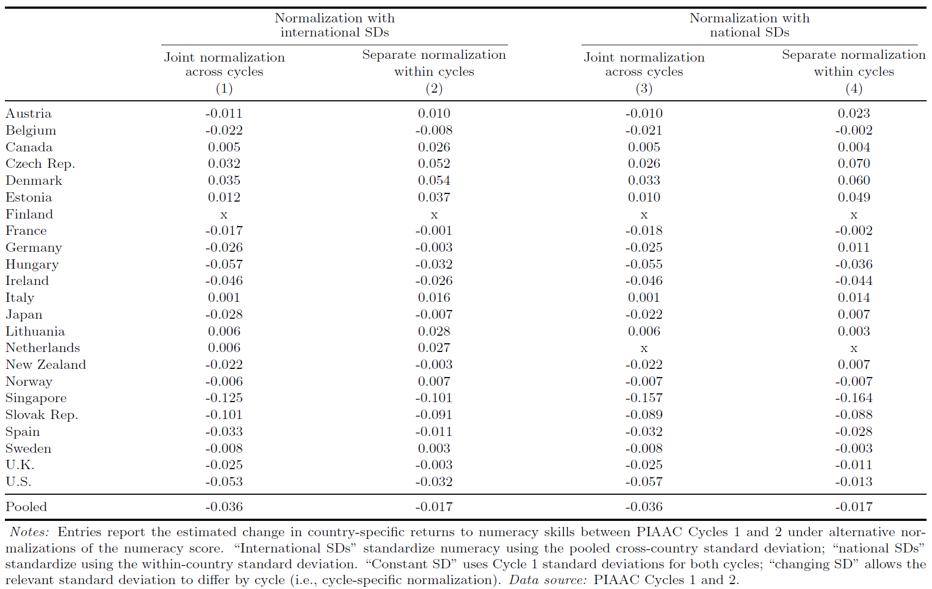
Alternative Normalizations and Estimated Dynamics

Slide 23
Alternative Normalizations and Estimated Dynamics

Slide 24
III. Factor Price Equalization

Slide 25
Factor Price Equalization
Considerable older testing literature
  Limited support
Three reasons to reconsider evidence:
  Substantial increase in global trade
  Shift toward information-based exchanges
    Prior emphasis on manufacturing
  Crude measures of labor skills and wage differences
    Current recognition of human capital

Slide 26
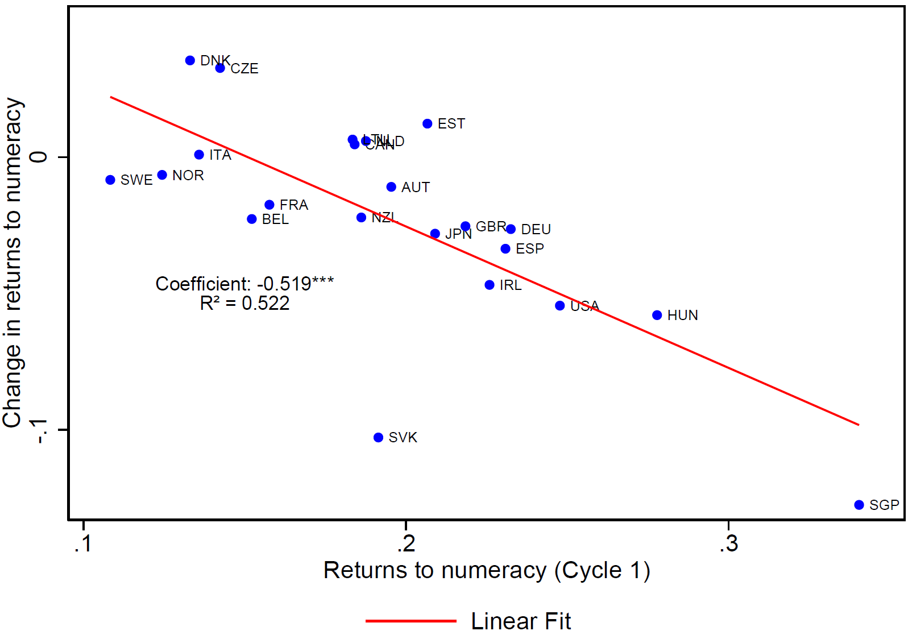
Convergence in Returns to
Cognitive Skills across Countries

Slide 27
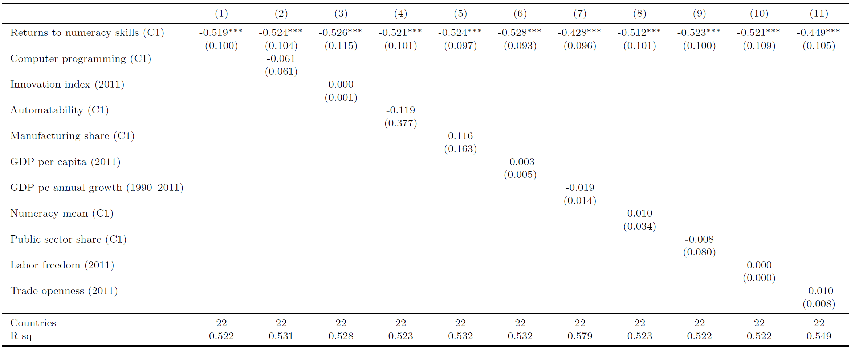
Differences in Convergence by Other Country Characteristics

Slide 28
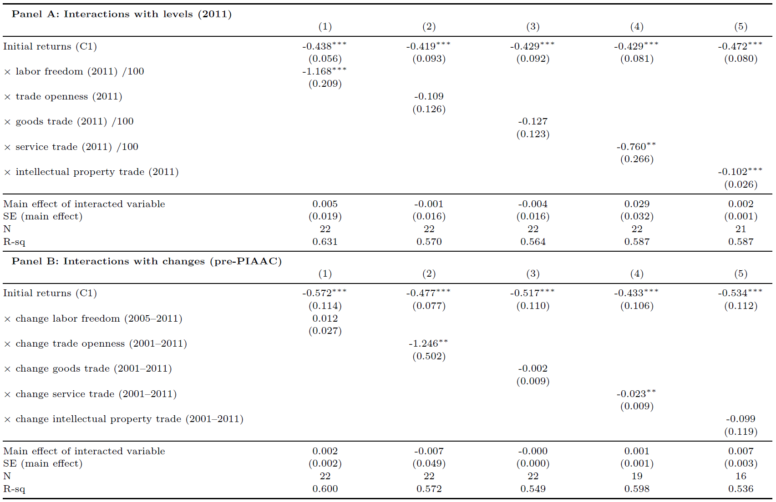
Speed of Convergence: Labor Freedom and Trade Openness

Slide 29
Robustness of the
Convergence Result
Could be generated by:
  Measurement error in country-specific return estimates
  Shifts in composition of estimation sample between the cycles
Three complementary checks show robustness:
Adjustment for reversion to the mean
  Bias-corrected convergence slope is -0.482 (baseline -0.519)
Restricting to stable subsample: native-born men

Slide 30
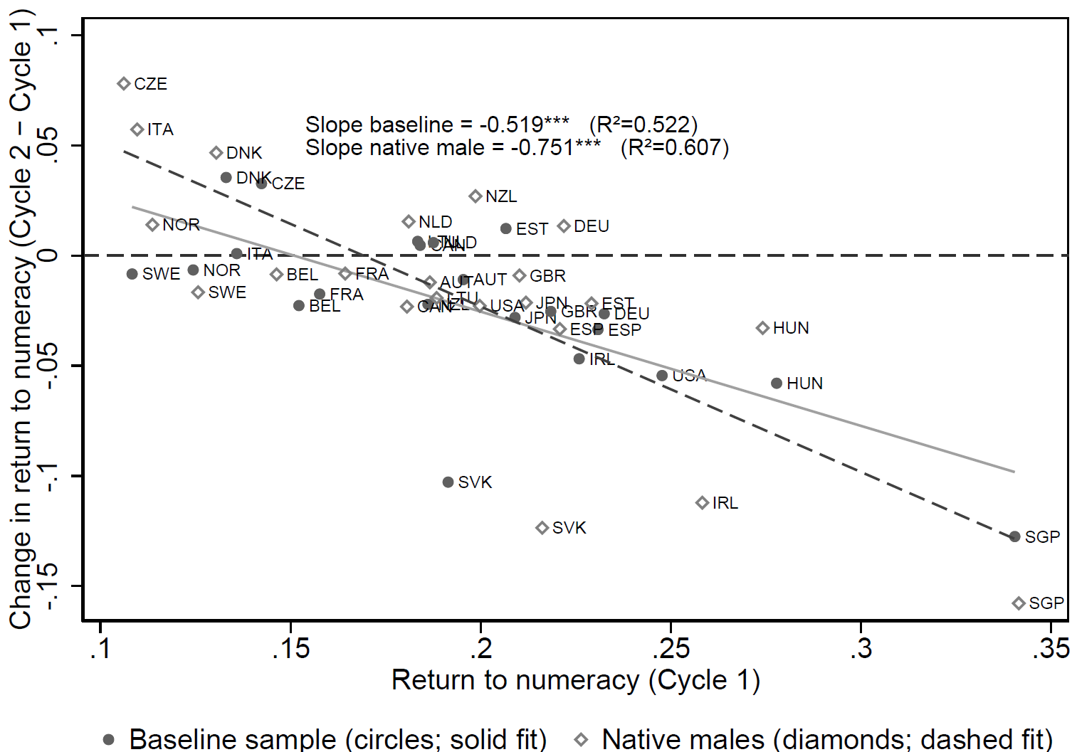
Convergence in Returns to Cognitive Skills: Sample of Native Males

Slide 31
Robustness of the
Convergence Result
Could be generated by:
  Measurement error in country-specific return estimates
  Shifts in composition of estimation sample between the cycles
Three complementary checks show robustness:
Adjustment for reversion to the mean
  Bias-corrected convergence slope is -0.482 (baseline -0.519)
Restricting to stable subsample: native-born men
Reweighting Cycle 2 to Cycle 1 composition

Slide 32
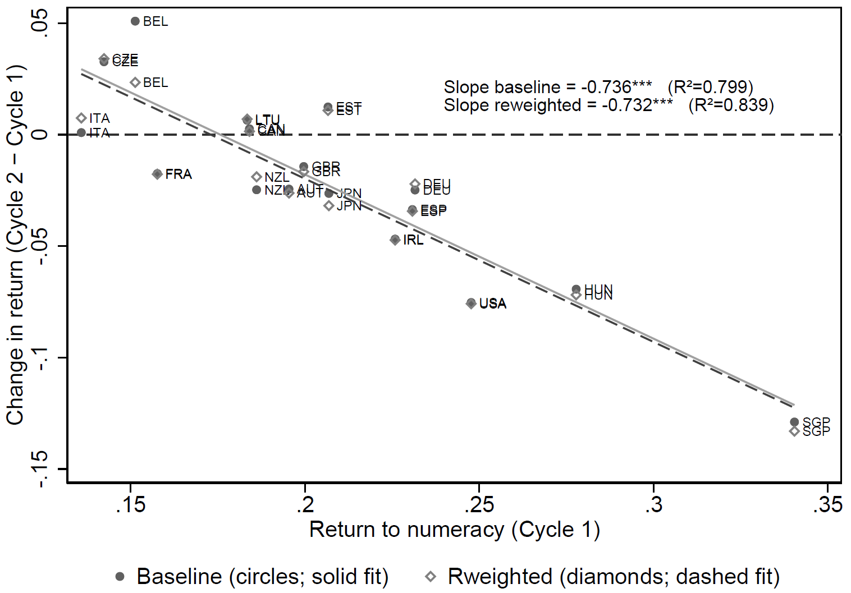
Convergence in Returns to Cognitive Skills: Sociodemographic Reweighting

Slide 33
Conclusions

Slide 34
The Evolution of Returns to
Cognitive Skills across Countries
Five insights into labor-market returns to skills:
Large returns to cognitive skills
  16.7% per SD in numeracy skills
Estimates hardly affected by non-cognitive skills
Slightly decreased returns to skills with substantial heterogeneity
  Decline from 20.3% in 2012, but ⅓ with increased returns
Strong tendency toward factor price equalization
  1pp higher initial returns → 0.5pp reduction
  Accounts for >½ of variation
  Other factors including technological change do not contribute
Speed of convergence in skill returns is faster with
  Larger openness to (intangible) trade
  More flexible labor markets

Slide 35
hanushek@stanford.edu https://hanushek.stanford.edu/
Thank you!

Slide 36
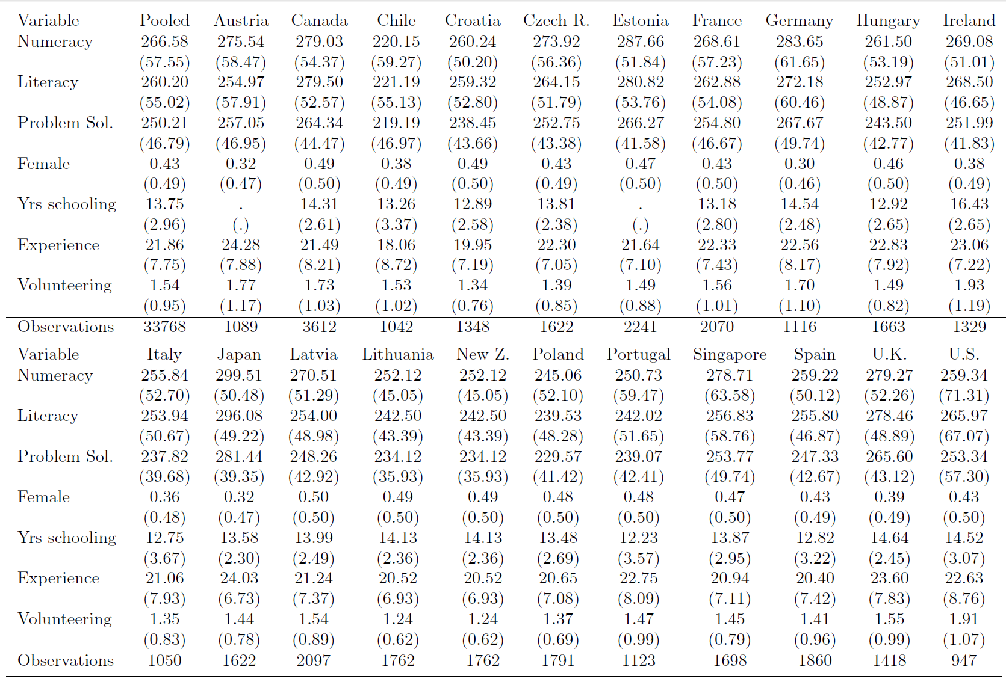
Descriptive Statistics

Slide 37
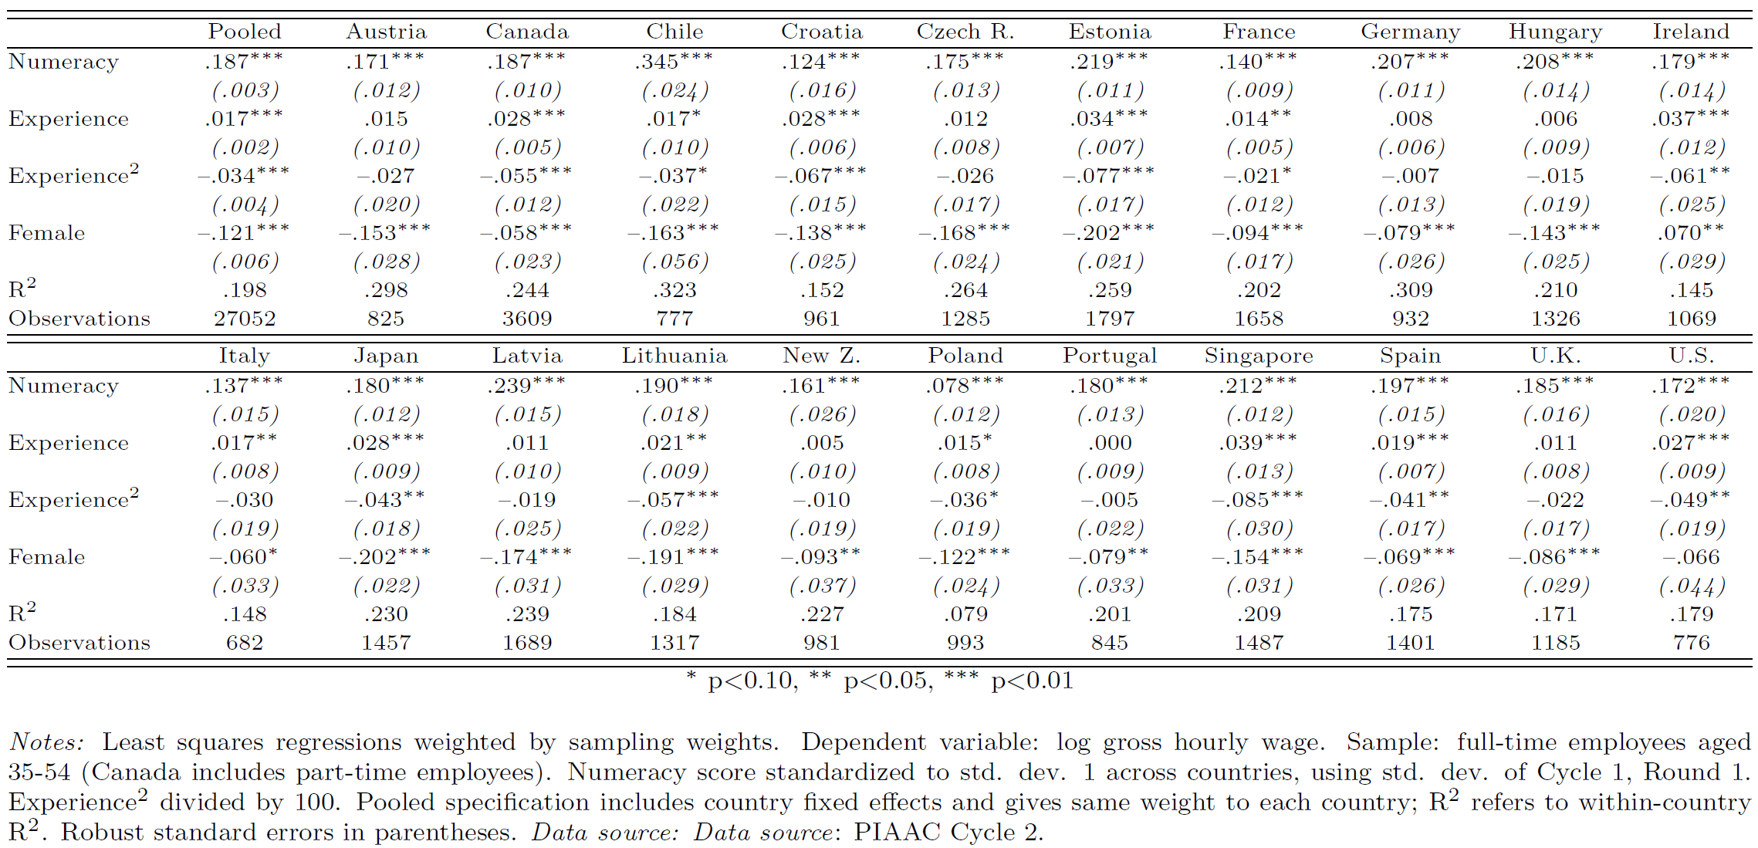
Returns to Cognitive Skills around the World, 2023

Slide 38
Returns to Literacy Skills around the World, 2023
15.2%

Slide 39
Returns to Numeracy and
Literacy Skills across Countries

Slide 40
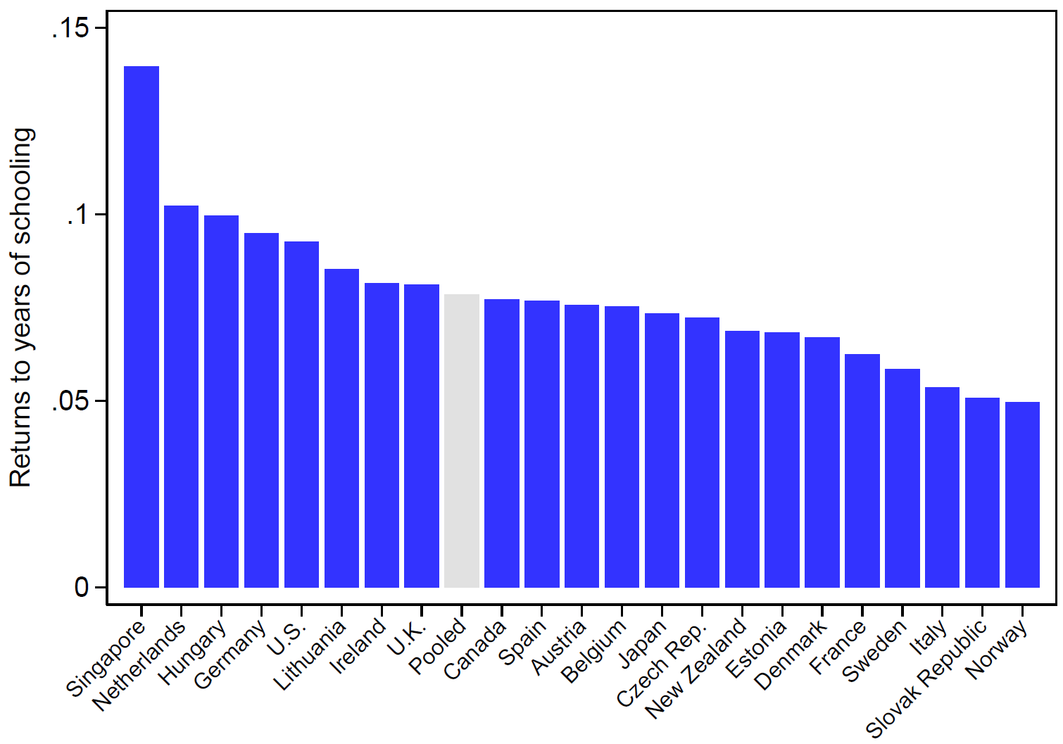
Returns to Years of Schooling:
Mincerian Wage Regressions

Slide 41
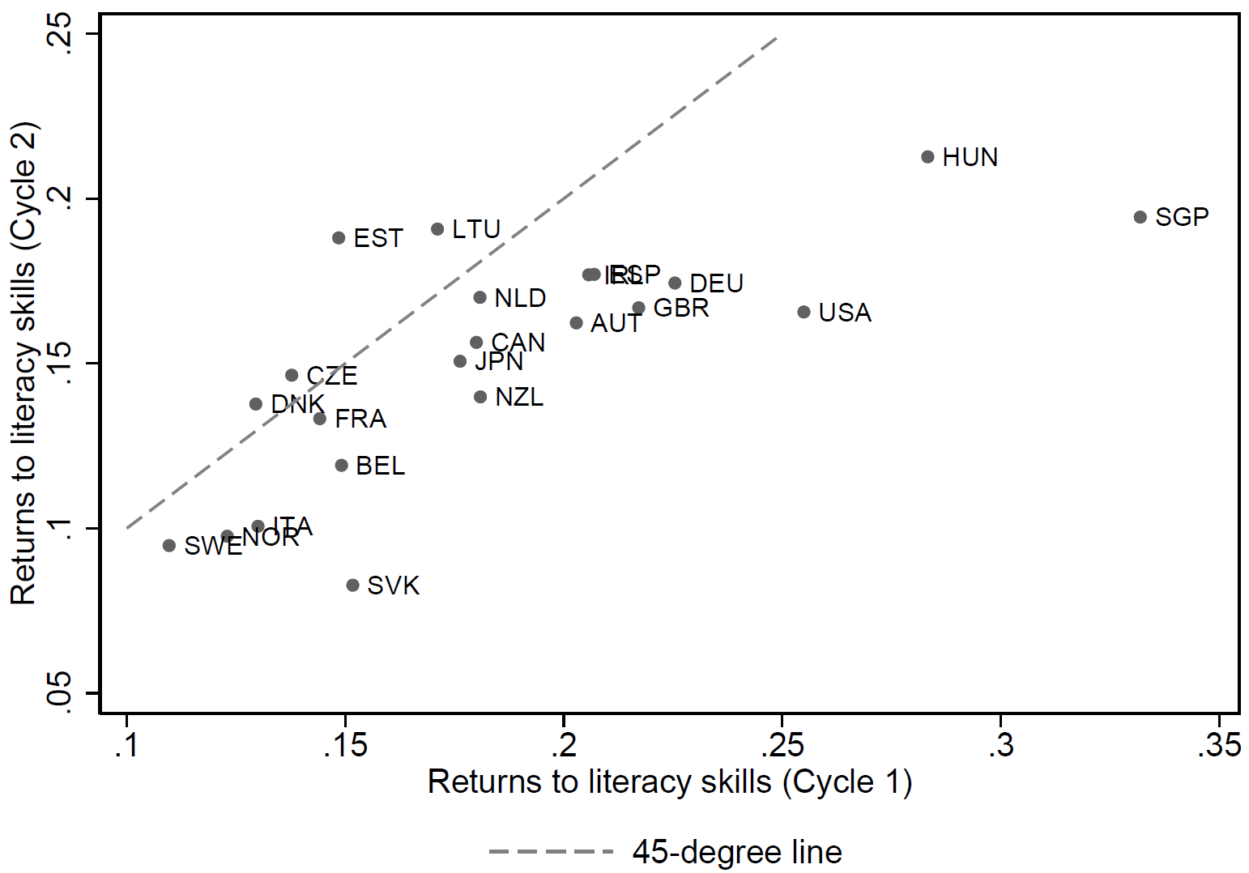
Returns to Literacy Skills:
2012 vs. 2023

Slide 42
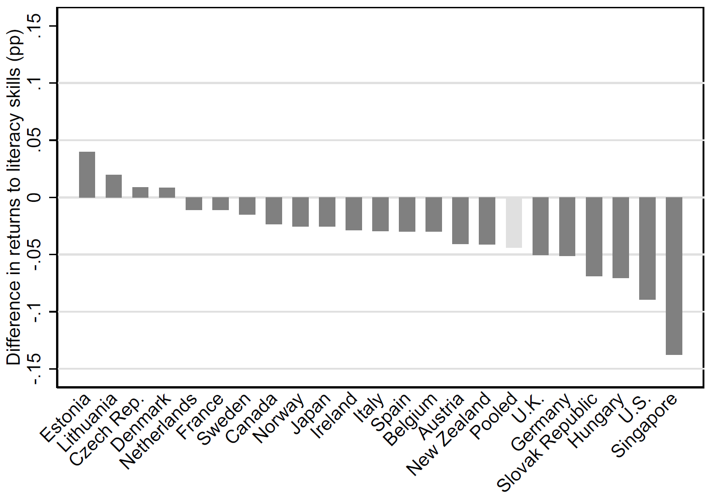
Changes in Returns to Literacy Skills, 2012-2023

Slide 43
Changes in Returns to Cognitive Skills: Controlling for Volunteering

Slide 44
Standard Deviation in Cognitive Skills, 2012 and 2023

Slide 45
Convergence in Returns to Cognitive Skills: Sample of Native Males

Slide 46
Convergence in Returns to Cognitive Skills: Sociodemographic Reweighting

Slide 47
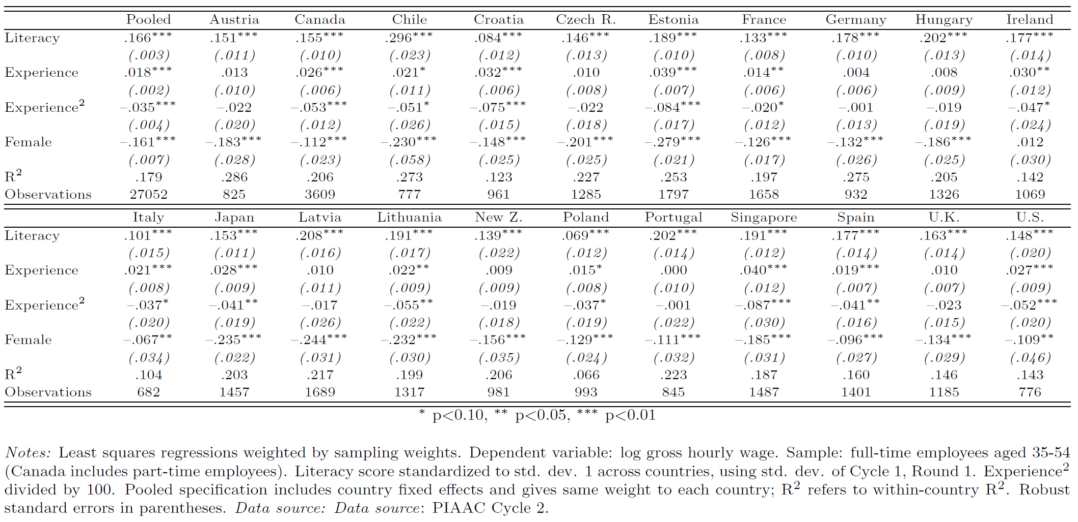
Returns to Literacy Skills, 2023

Slide 48
Returns to Cognitive Skills:
Accounting for Non-cognitive Skills

Slide 49
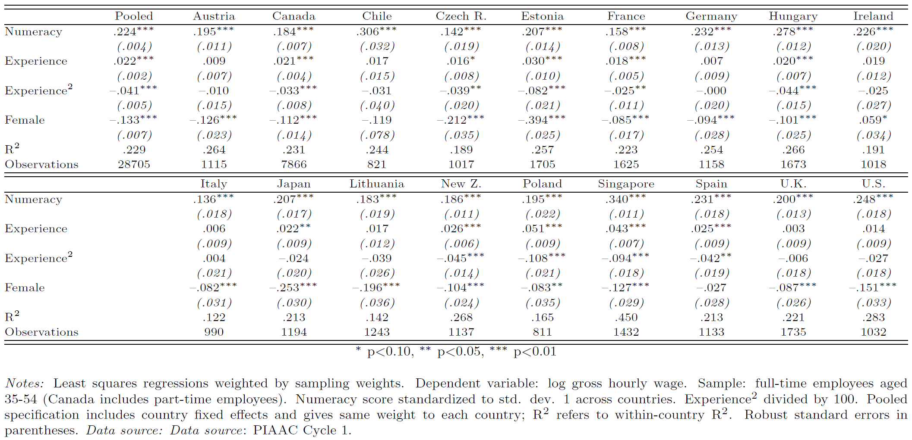
Returns to Numeracy Skills, 2012

Slide 50
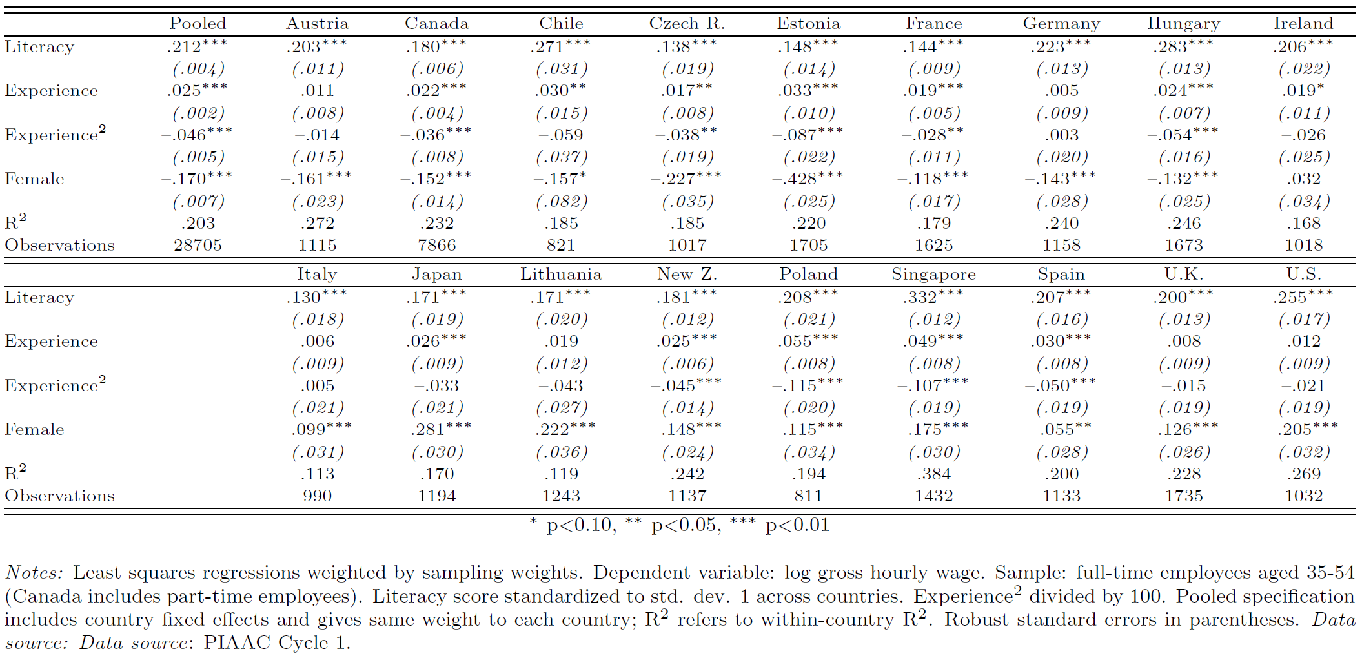
Returns to Literacy Skills, 2012

Slide 51
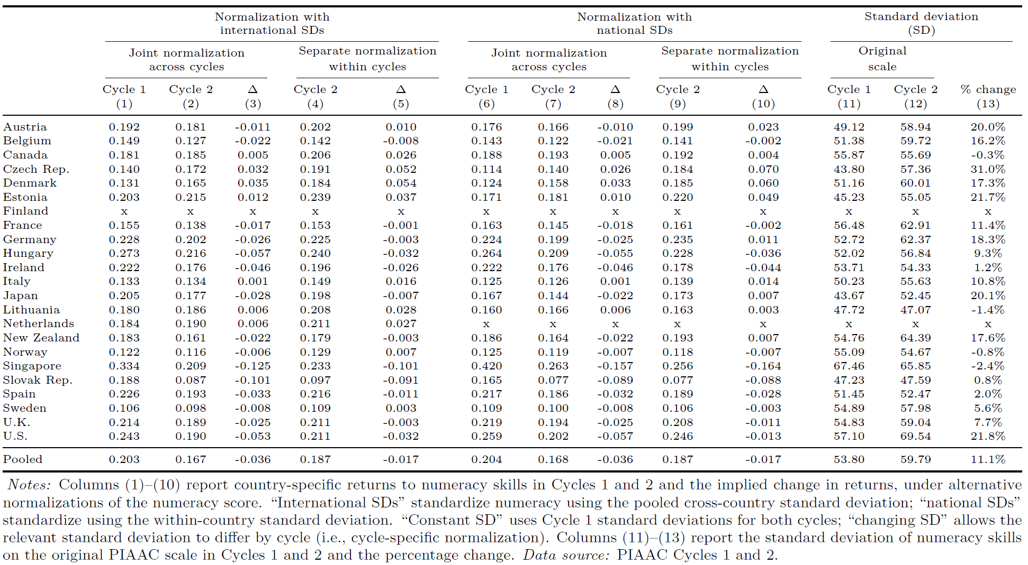
Alternative Normalizations and Estimated Dynamics of Skill Returns

Slide 52
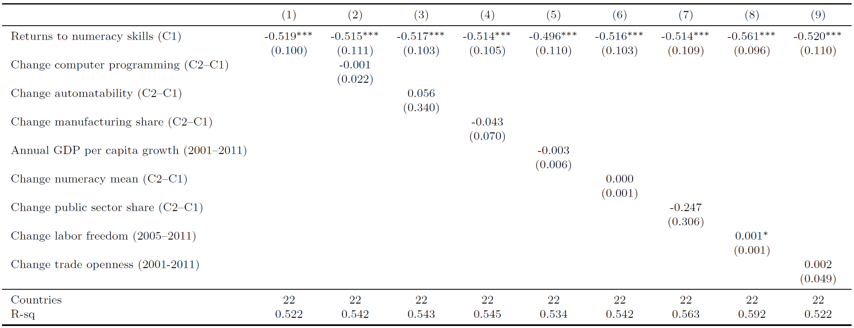
Explaining Differences in Changes in Skill Returns: Change in Country Characteristics

Slide 53
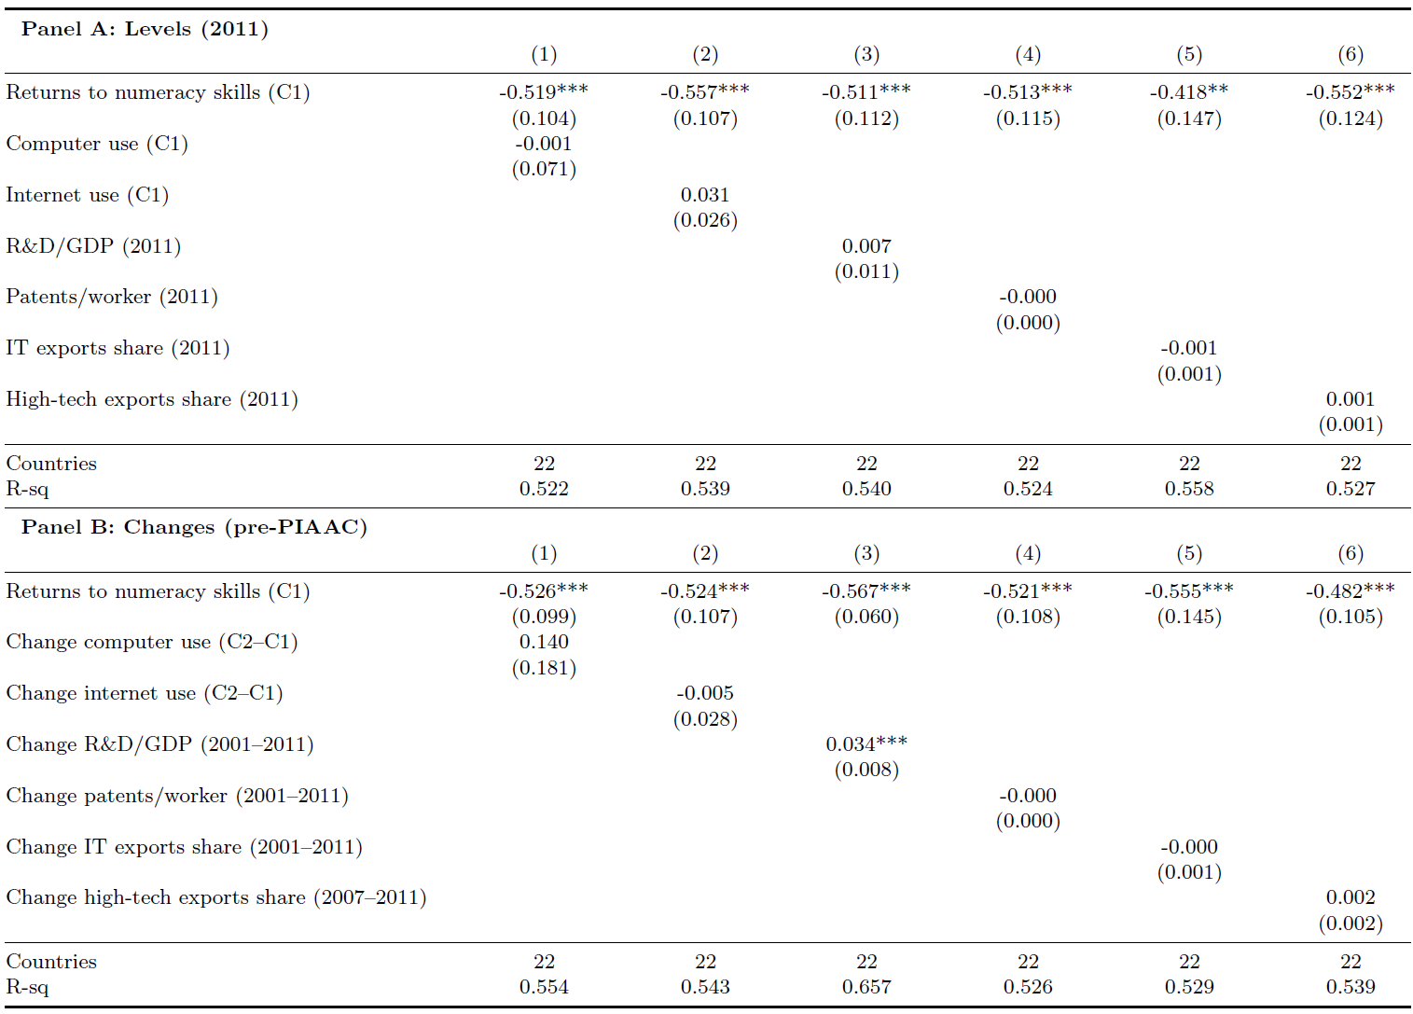
Explaining Differences in Changes in Skill Returns: Technology Measures

Slide 54
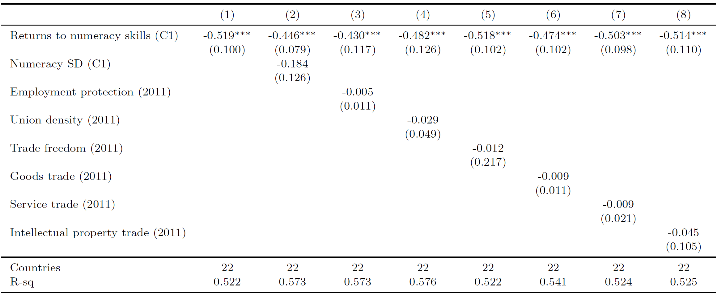
Explaining Differences in Changes in Skill Returns: Further Country Characteristics

Slide 55
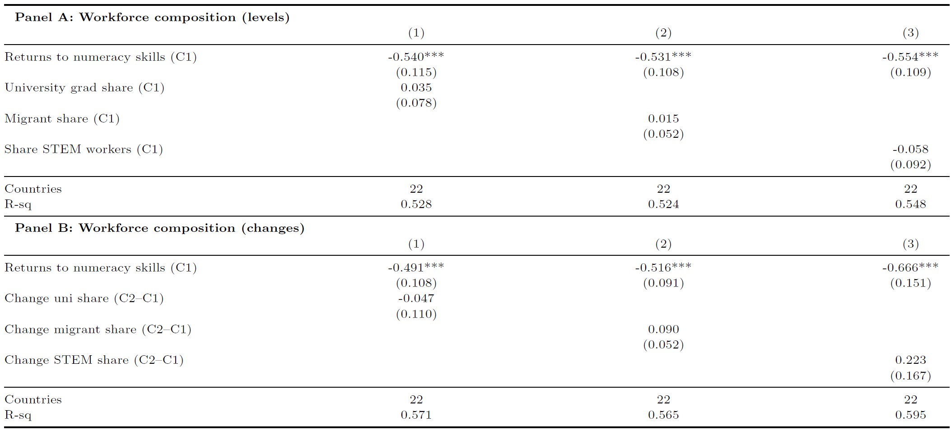
Explaining Differences in Changes in Skill Returns: Workforce Composition

Slide 56
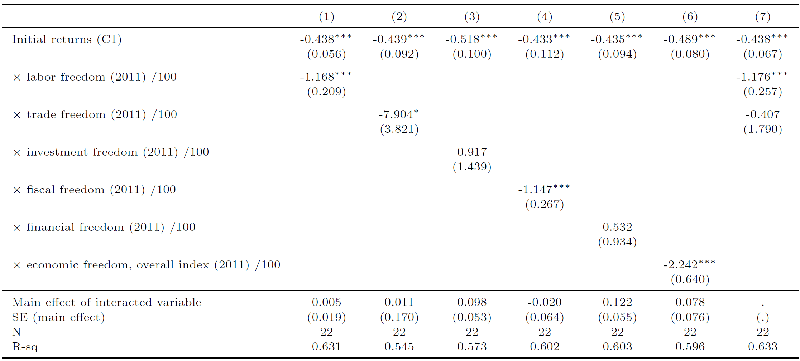
Explaining the Speed of Convergence: Alternative Freedom Measures

Slide 57
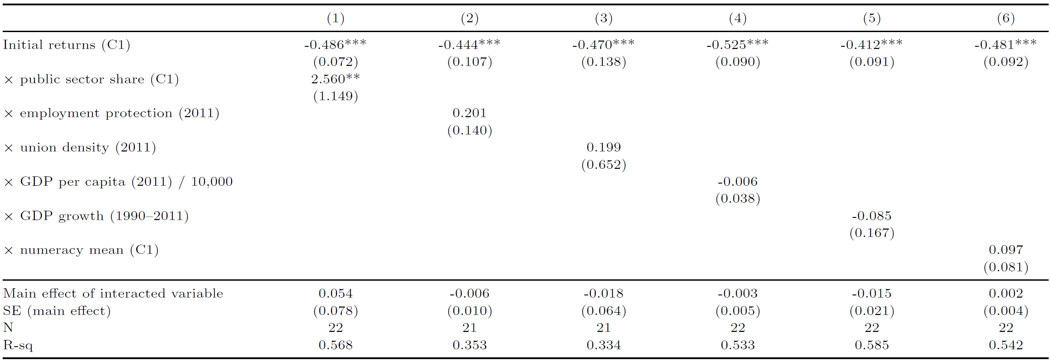
Explaining the Speed of Convergence: Other Country Characteristics

Slide 58
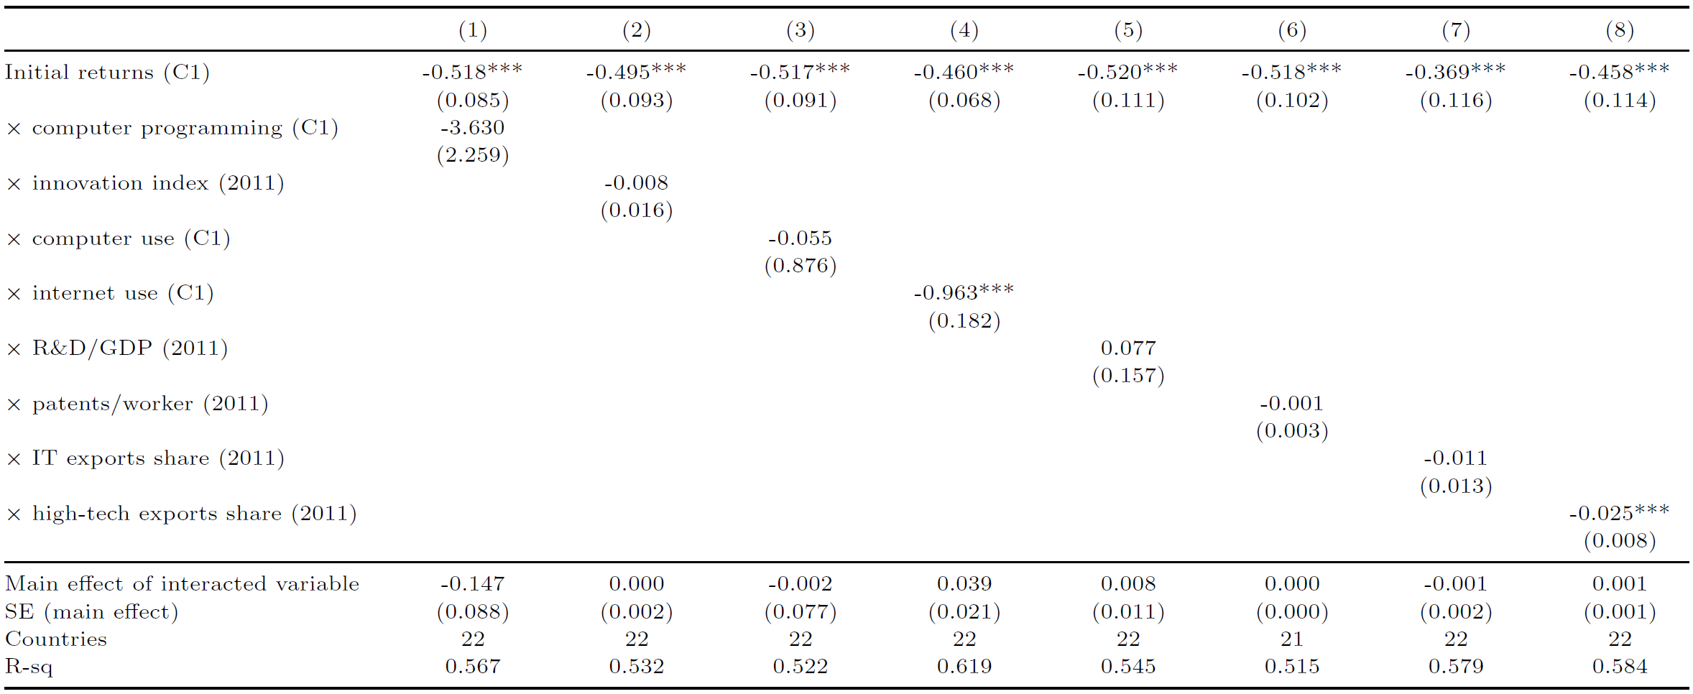
Explaining the Speed of Convergence: Other Country Characteristics

