Slide 1
The 2016 Presidential Election in Context
Morris Fiorina
Hoover Institution
January 12, 2017

Slide 2
An Era of Unstable Majorities
 | President | House | Senate
1992 | D | D | D
1994 | D | R | R
1996 | D | R | R
1998 | D | R | R
2000 | D/R | R | Tie
2002 | R | R | R
2004 | R | R | R
2006 | R | D | D
2008 | D | D | D
2010 | D | R | D
2012 | D | R | D
2014 | D | R | R
2016 | D/R | R | R
Notes:
Messy table … 6 different patterns in 12 elections v. only 3 in 19 elections
Nothing like this since the late 19th Century (Brady will discuss)
2018 could shift again if Reps lose 24 seats (Reagan lost 26 in 1982)

Slide 3
WHY?
The U.S. Political Parties Have Become More Like the Ideological Parties of 20th Century Europe

Slide 4
Polarization
Time 1 33 Libs 34 Mods 34 Conservs
Time 2 50 Libs 0 Mods 50 Conservs
Time 1 33 Dems 34 Inds 33 Reps
Time 2 50 Dems 0 Inds 50 Reps

Slide 5
No Decline in Moderates
Source: GSS

Slide 6
No Decline in Independents
Source: ANES

Slide 7
Issue Centrists Still Dominate: 2012
Source: ANES
* “Haven’t thought much about it” responses recoded as moderates

Slide 8
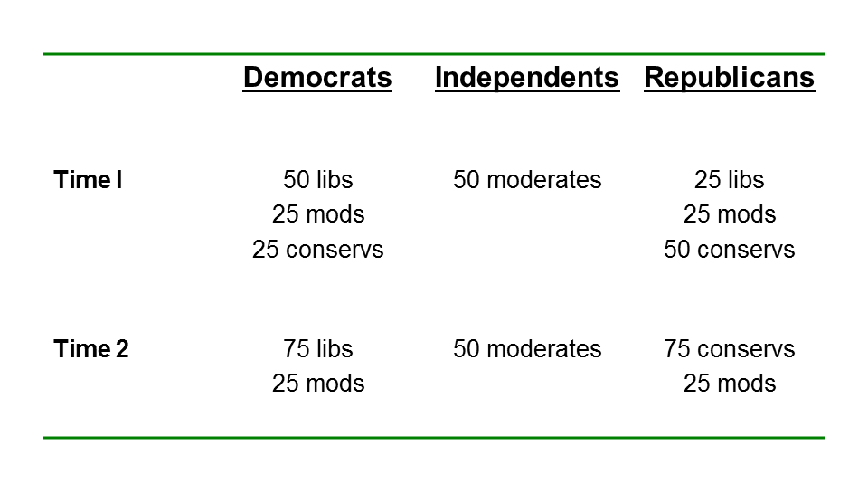
Sorting
Notes:
What we have is sorting which has led to polarization of the two parties

Slide 9
Sorting → Partisan Polarization
L ________________________________ R
-1 -.25 0 .25 +1
L __________________________________________ R
-1 -.75 0 .75 +1

Slide 10
The Problem with European-Style Parties in the United States:
Only two of them

Slide 11
Most Advanced Democracies Have Multi-Party Coalition Governments
 | # of Parties in Govern | # of Parties With Seats
Australia | 4 | 9
Austria | 2 | 10
Belgium | 4 | 12
Czech Republic | 3 | 7
Finland | 4 | 10
France | 4 | 17
Germany | 3 | 5
Ireland | 2 | 10
Italy | 6 | 10
Japan | 5 | 12
Luxembourg | 3 | 6
Netherlands | 2 | 12
Sweden | 2 | 8
United Kingdom | 1 | 10

Slide 12
Two Sizes Fit All?
Platform
1 2 3 4 5 6 7 8
Foreign C C C C A A A A
Economic G G M M G G M M
Cultural P T P T P T P T
          (D) (R)
          (L) (ND)

Slide 13
Two Sizes Fit All?
Platform
1 2 3 4 5 6 7 8
Foreign C C C C A A A A
Economic G G M M G G M M
Cultural P T P T P T P T
          (D) (R)
          (T?) (T?) (T?)

Slide 14
Do Any of the Parties Represent Your Views Reasonably Well? (YouGov/Polimetrix 2015)

Slide 15
Unstable Majorities
Ideological parties in the U.S. context overreach
→ attempt to implement base priorities
→ alienates marginal supporters
→ electoral reaction

Slide 16
Marginal Members of an Electoral Majority?
(PEW Research Center)

Slide 17
How Independents Vote in Presidential Elections
Notes:
In 16 elections, winner won independents in 13. Exceptions?

Slide 18
How Independents Vote in House Elections
Source: National Election Pool
Notes:
Ping-pong: no sign of ending soon

Slide 19
Explaining the Trump Vote
Racism, misogyny, xenophobia

Slide 20
For anyone who voted for Donald Trump, bald-faced racism and sexism were not the deal-breakers they should have been. Hatred of women was on the ballot in November, and it won. (emphasis in original)
Donald Trump has won the presidency, despite an unprecedented level of unfitness and in defiance of nearly every prediction and poll. And he’s done this not despite (sic) but because he expressed unfiltered disdain toward racial and religious minorities in the country.
Broder: “Dark Age? Get a Grip People” (2004)

Slide 21
“The Day the Enlightenment Went Out”
Where else [but in the red states] do we find fundamentalist zeal, a rage at secularity, religious intolerance, fear of and hatred for modernity? … We find it in the Muslim world, in Al Qaeda, in Saddam Hussein’s Sunni loyalists. (Gary Wills)
We’re entering another dark age, more creationist than cutting edge, more pre-modern than postmodern. (Maureen Dowd)
Notes:
Narrative peaked in 2004.

Slide 22
Some Perspective
Clinton carried PA, MI, WI by about 83,000 votes
(.0006% of national vote)
Change half, properly distributed, giving her a comfortable EC majority, and
→ “Americans Reject Racism, Sexism!”

Slide 23
Preliminary
Racism?
Obama approval rating
Aggregate election returns
Sexism?
Does Trumps treatment of women bother you?
Yes: 63 %
A lot: 50%
(Clintonism?)

Slide 24
Explaining the Trump Vote
Racism, misogyny, xenophobia
General discontent (eg. Economic)
Specific issues (eg. Immigration)
Anti-elitism
  Economic (eg. Wall Street)
  Political (eg. The Democratic Party)
  Cultural (eg. “Deplorables”)
  Media

Slide 25
Start with Hillary Clinton
“Donald Trump and Hillary Clinton head into the final hours of the 2016 presidential campaign with the worst election-eve images of any major-party presidential candidates Gallup has measured back to 1956.”

Slide 26
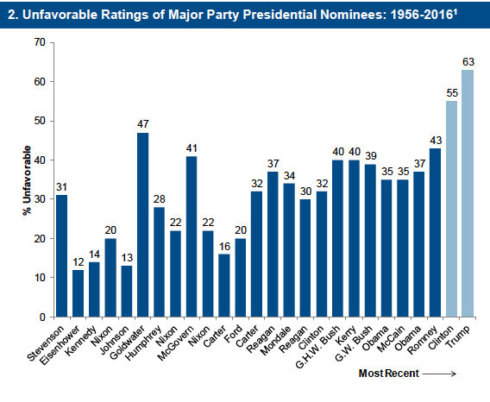
Notes:
Biden

Slide 27
Voted for Trump in Spite of …
Trump HRC
Favorable Opinion 38 % 43
Qualified 38 52
Honest and Trustworthy 33 36
Right Temperament 35 55
Bring Needed Change 83 14

Slide 28
Beyond the U.S.
2015 UK General Elections
Brexit
Trump
Populist (“Far Right”) Resurgence

Slide 29
Support for Populist Parties in Western European Democracies
Swiss People’s Party 26.6%
Freedom Party of Austria 20.5
New Flemish Alliance 20.3
Progress Party (Norway) 16.3
National Front (France) 13.6
Sweden Democrats 12.9
United Kingdom Independence Party 12.6
Danish People’s Party 12.3
Party for Freedom (Netherlands) 10.1
*Popular vote in most recent national election
Source: “List of Active Nationalist Parties in Europe.” Wikipedia. http://en.wikipedia.org/wiki/List_of_active_nationalist_parties_in_Europe

Slide 30
Historical Similarities
Globalization
Economic Transformation
Population Movement
Mass Immigration
Rising Inequality
Notes:
Niall and I / Even if Trump flames out, cleavages not going away fast, and likely will lead to a restructuring of the party system

Slide 31
The End
Thank you!

Slide 32
When Should Abortion Be Permitted?
“Always as a Matter of Personal Choice”
Source: ANES. Workers are strong and weak partisans who worked for a party or candidate. Donors are strong and weak partisans who donated to a party or candidate,
Notes:
Graduations of sorting

Slide 33
The Re-Nationalization of
American Elections
1930s-1980s—vote for the person, not the party
1990s-today—vote for the party, not the person
→ Decline in ticket splitting
Notes:
Sorted parties plus national funding → similar candidates. As a result people vote for the party not the person

Slide 34
Split Ticket (President/House) Voting Has Declined in Recent Decdes
Source: ANES. 2012 data FTF only.
Notes:
The micro-mechanism is split-ticket voting
2. Occurs when citizens vote for House and presidential candidates for different reasons and/or H and P candidates adopt different positions, but as parties sort …

Slide 35
When Should Abortion Be Permitted?
(2012 ANES)
 | Strong Democrats | Strong Republicans
Never permitted | 9% | 21%
Only in case of rape, incest, or the woman's life is in danger | 17 | 40
For a clear need | 14 | 18
Always as a personal choice | 60 | 22
Source: ANES, 2012 FTF Only
Notes:
Even on abortion there are strong Democrats and strong Republicans whose views are “wrong”

Slide 36
Electoral Chaos ☺
1992: Ross Perot--19% / Clinton—43% (1912)
1994: Democrats 40 year reign in the House ends
1996: Democratic President / Republican Congress !
1998: President’s party gains seats in the House!
2000: Total Mess
2002: President’s party gains seats again!
2004: Consolidation of the Reagan Revolution?
2006: No--Republican “thumpin”
2008: Resurrection of The New Deal?
2010: No--Democratic “shellacking I”
2012: Status quo, but Obama …
2014: Democratic “shellacking II”
2016: Trump

Slide 37
Presidential Forecasting Models
Erikson (economic indicators/polls 52.0 D (82%)
& Wlezien
Lockerbie (economic expectations/ 50.4 D (62%)
1st term
Lewis-Beck (Approval/growth) 51.1 D (83%)
&Tien
Campbell (convention/growth) 51.2 D (75%)
Abramowitz (Approval/growth/ 48.6 D (66%)
1st term)
Norpoth (primaries) 47.5 D (87%)

