Slide 1
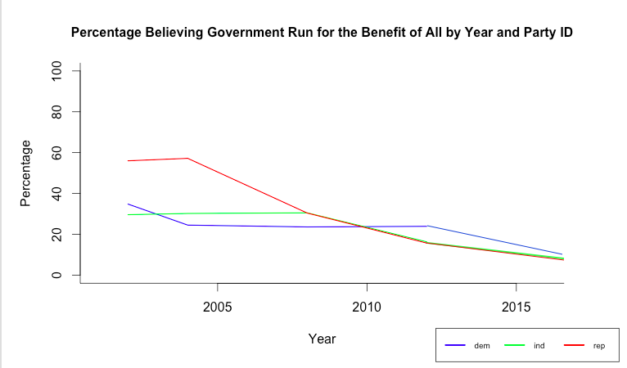
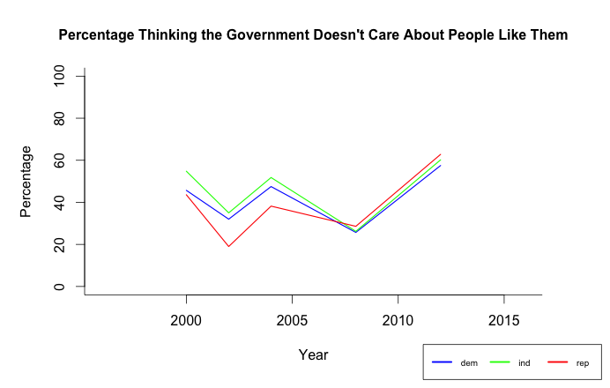

Slide 2
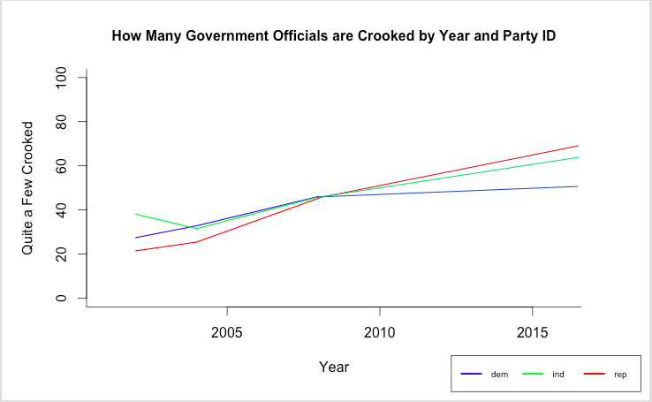
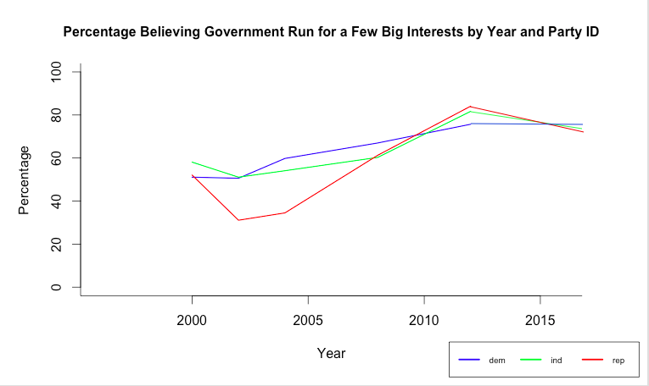

Slide 3
Democrats first----Easier
Supposed to be another Hillary coronation --Why not ?
She was unpopular July 2015
Democrats Independents Republicans
Fav unfav Fav unfav Fav unfav
77% 19% 32% 64% 12% 88%
Won’t vote for
14% 39% 87%

Slide 5
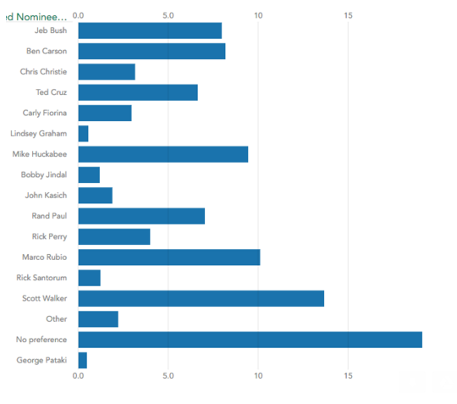
Personal finances were worse: preferences May/June

Slide 6
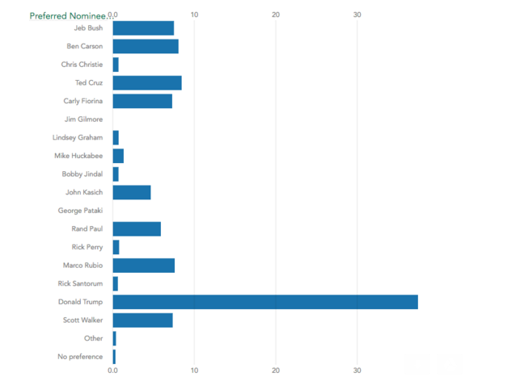
Personal finances were worse: preferences in July/August
41%

Slide 8
May/July-16 46% 67%

Slide 9
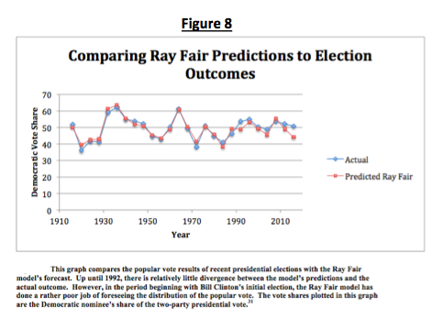

Slide 10
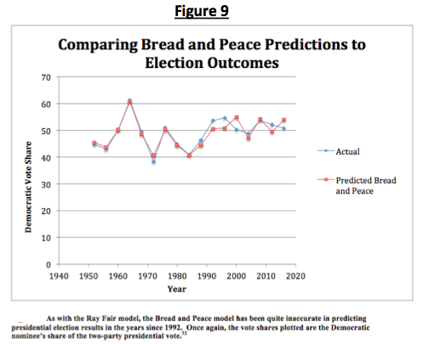

Slide 11
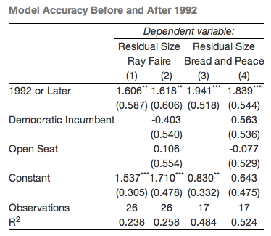

Slide 12
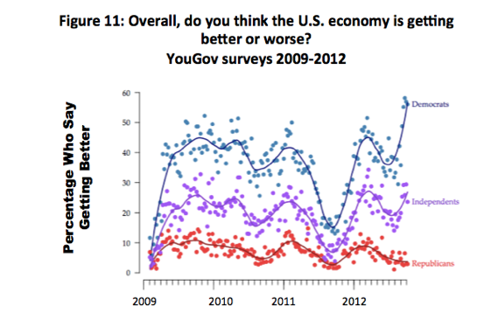

Slide 13
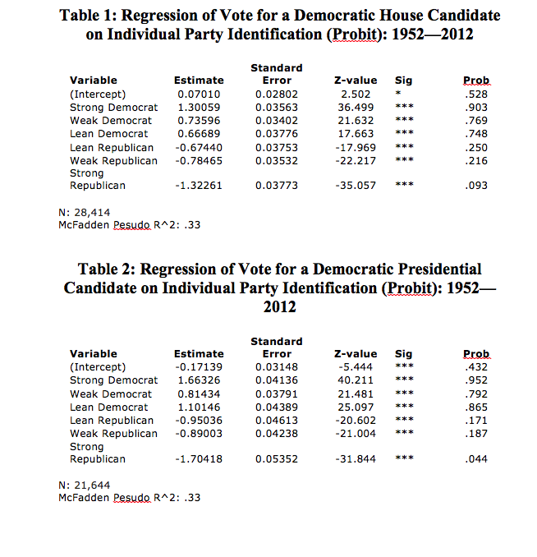

Slide 14
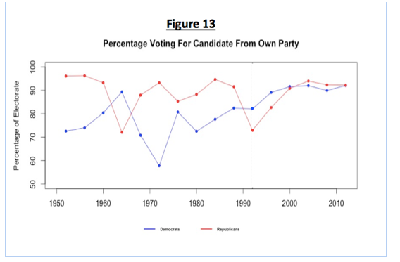

Slide 15
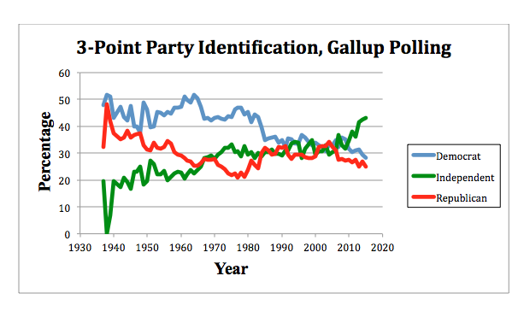

Slide 16
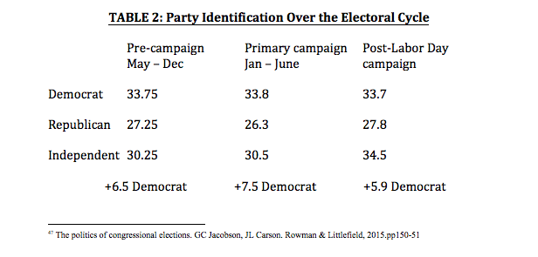

Slide 17


Slide 18
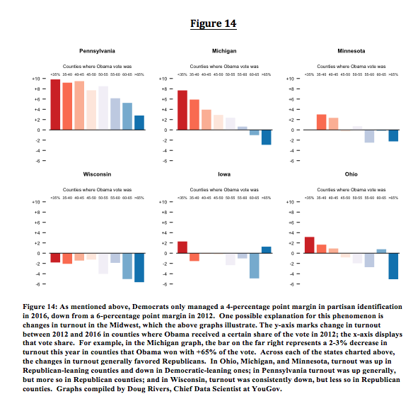

Slide 19
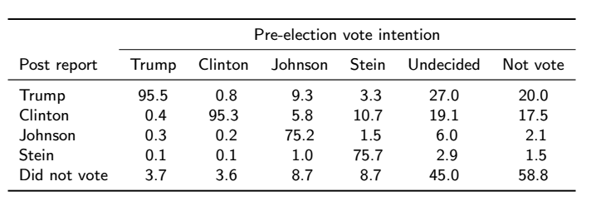

Slide 20
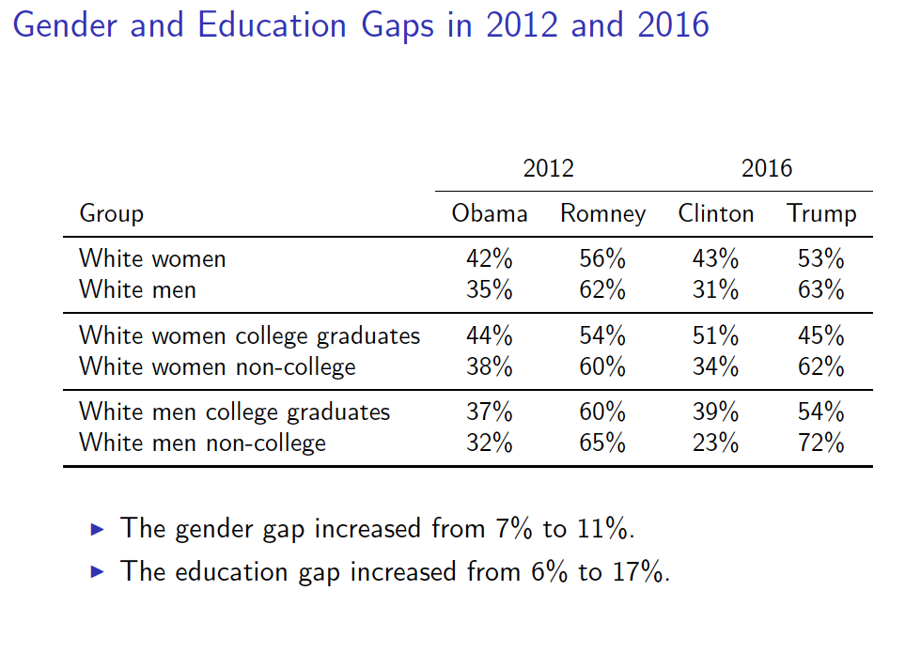

Slide 21
